Slide 1
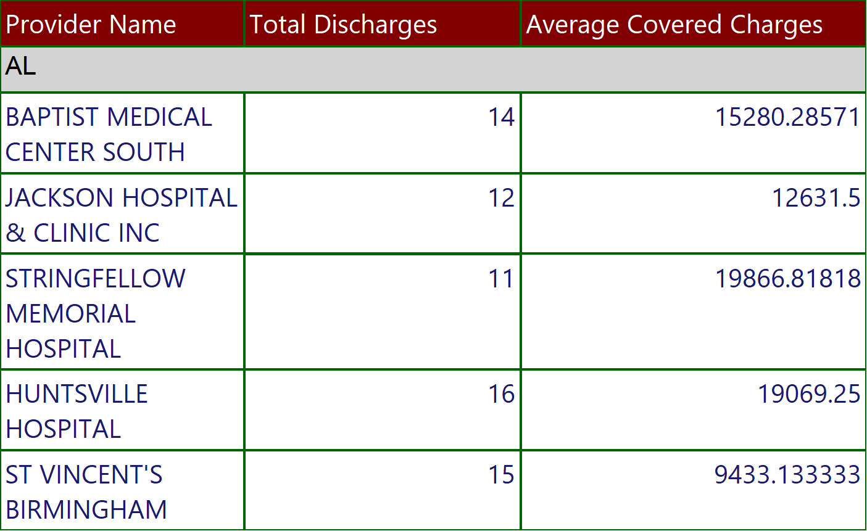
COVID STATE REPORT
Execution Time-10/13/2022 10:31:32 AM
1 of 174

Slide 2
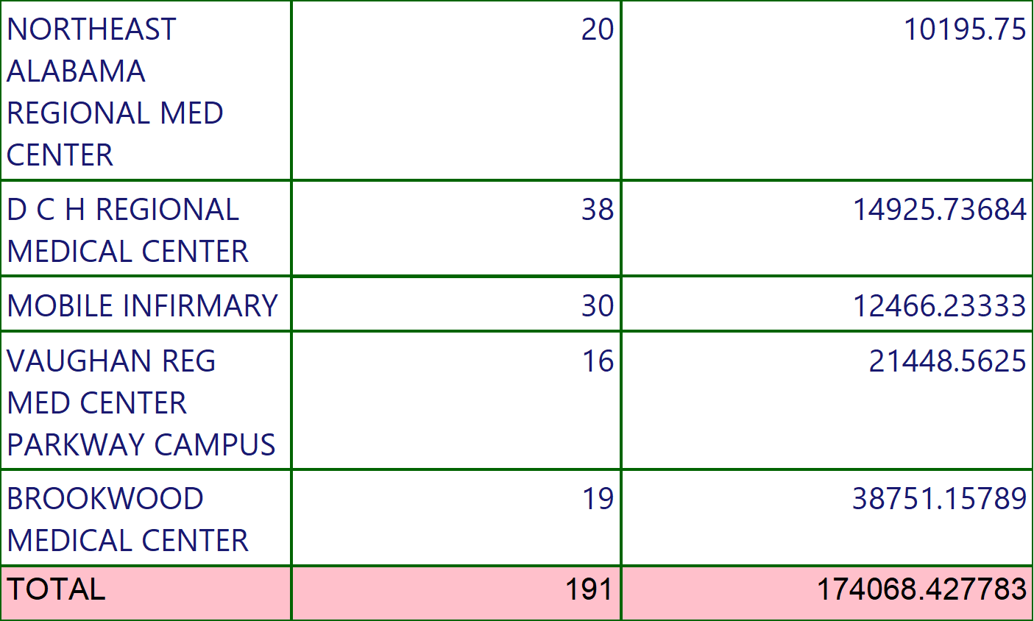
COVID STATE REPORT
Execution Time-10/13/2022 10:31:32 AM
2 of 174

Slide 3
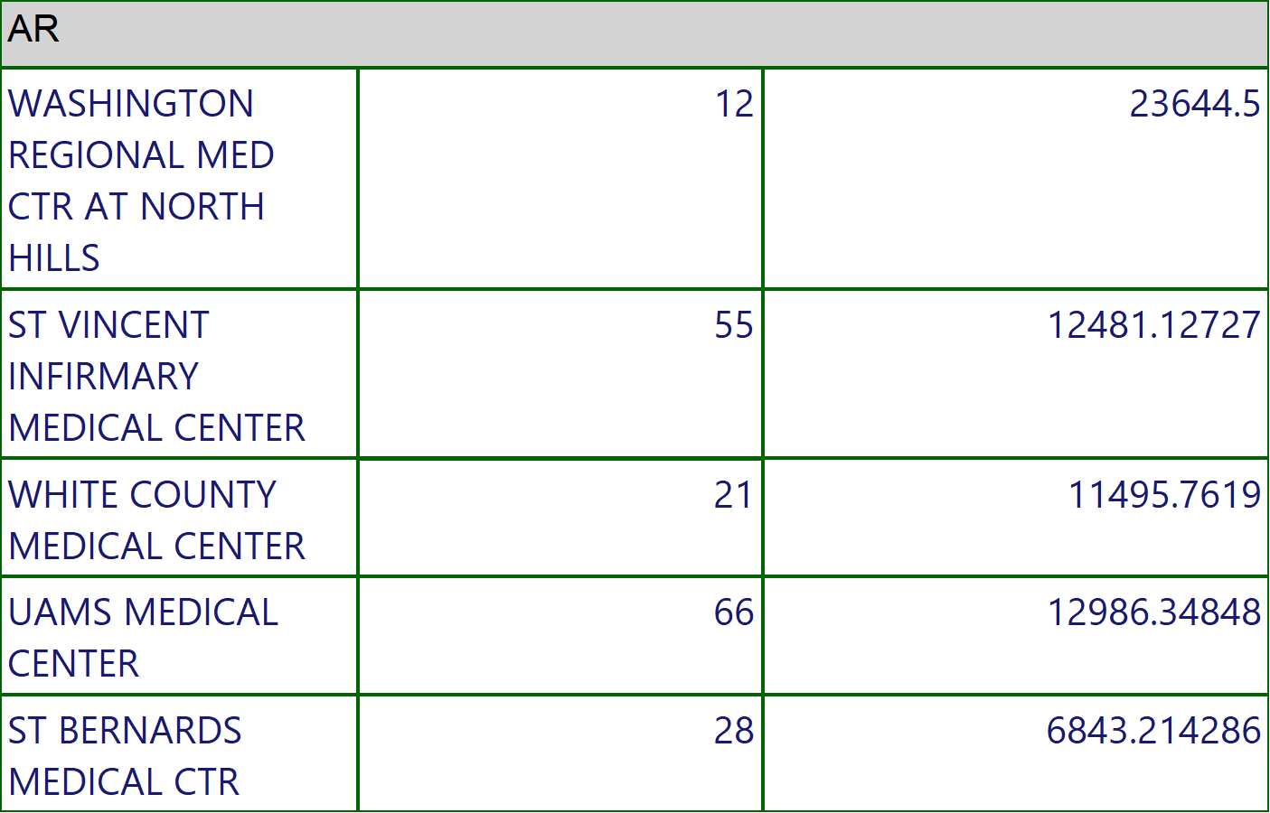
COVID STATE REPORT
Execution Time-10/13/2022 10:31:32 AM
3 of 174

Slide 4
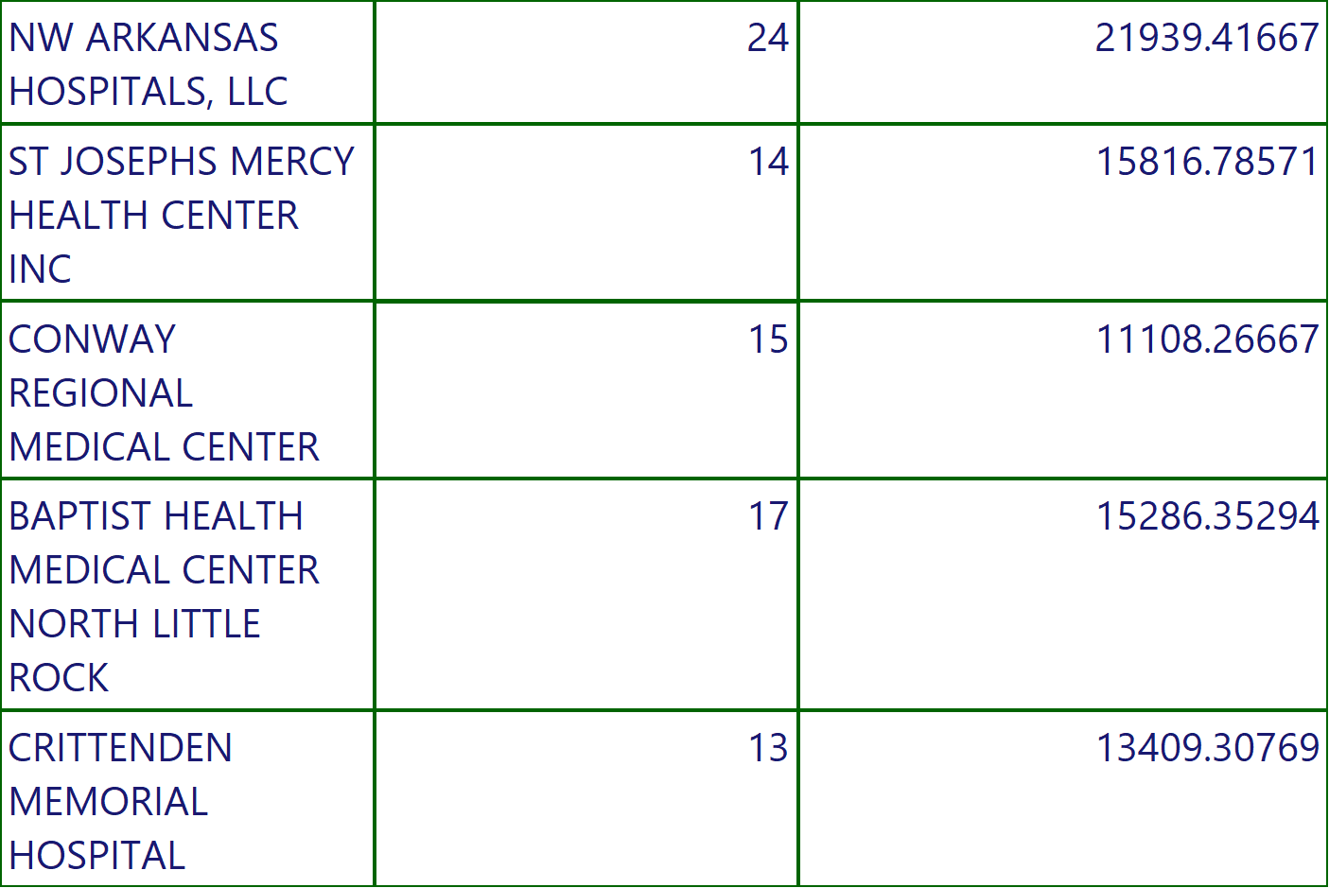
COVID STATE REPORT
Execution Time-10/13/2022 10:31:32 AM
4 of 174

Slide 5
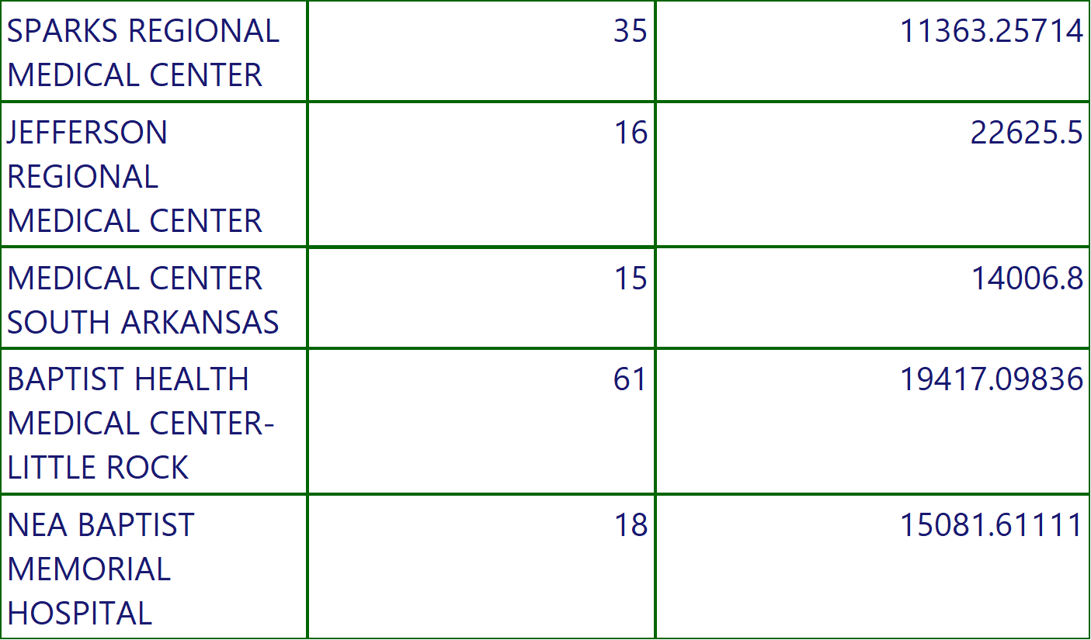
COVID STATE REPORT
Execution Time-10/13/2022 10:31:32 AM
5 of 174

Slide 6
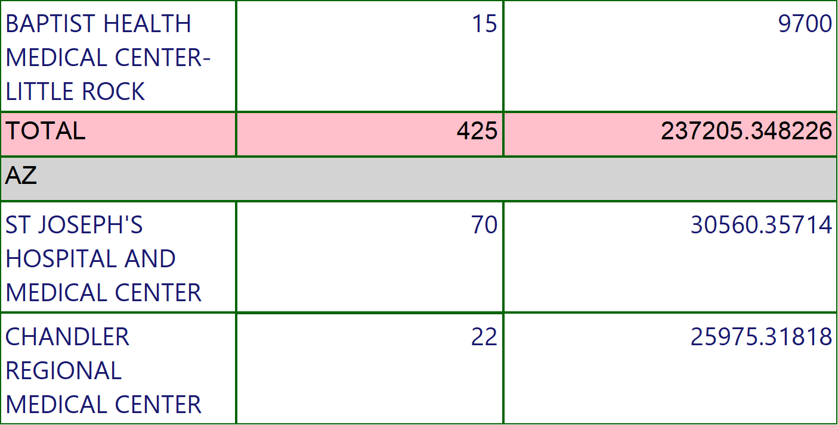
COVID STATE REPORT
Execution Time-10/13/2022 10:31:32 AM
6 of 174

Slide 7
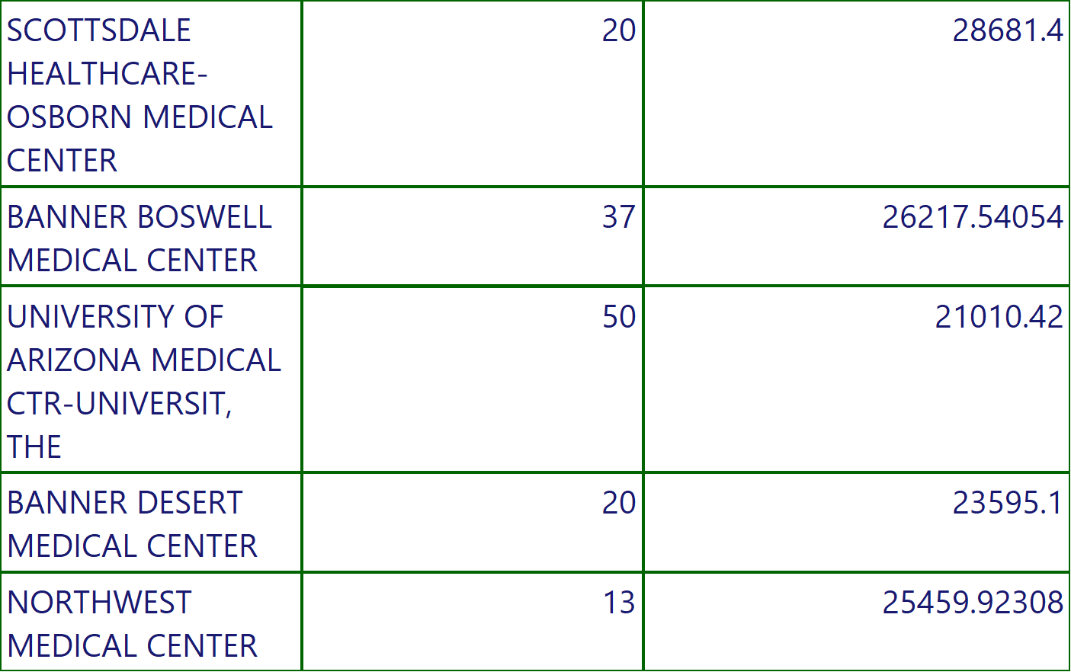
COVID STATE REPORT
Execution Time-10/13/2022 10:31:32 AM
7 of 174

Slide 8
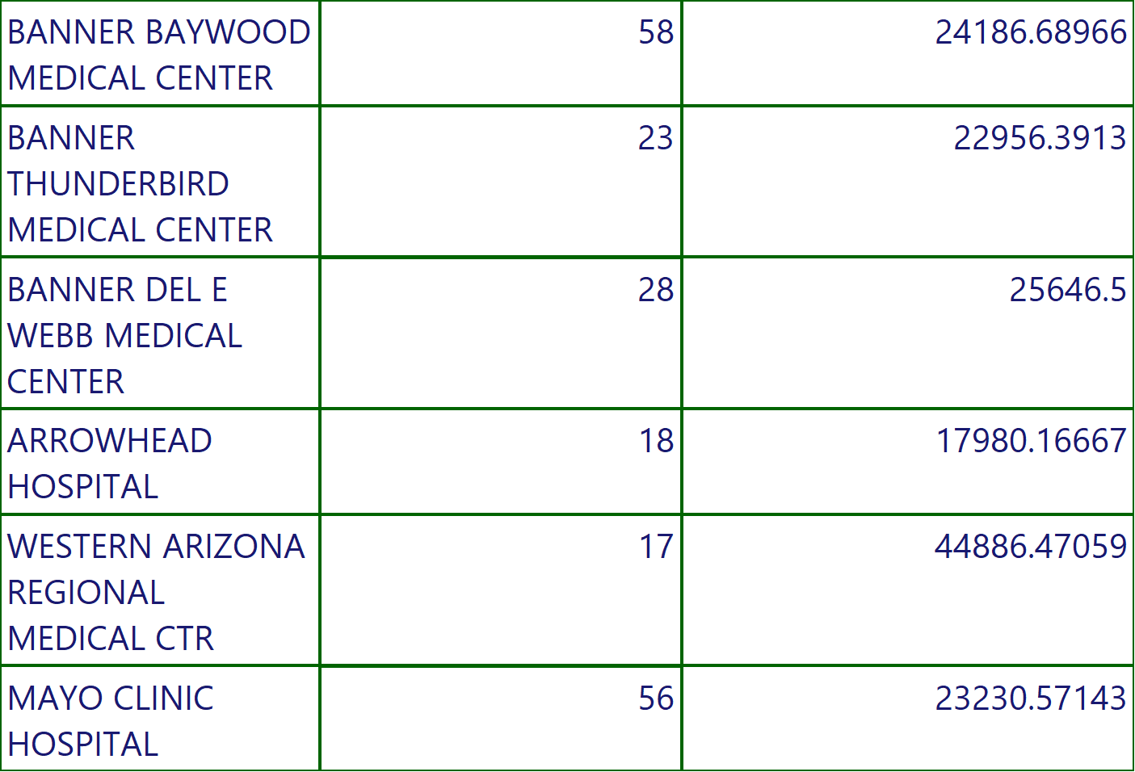
COVID STATE REPORT
Execution Time-10/13/2022 10:31:32 AM
8 of 174

Slide 9
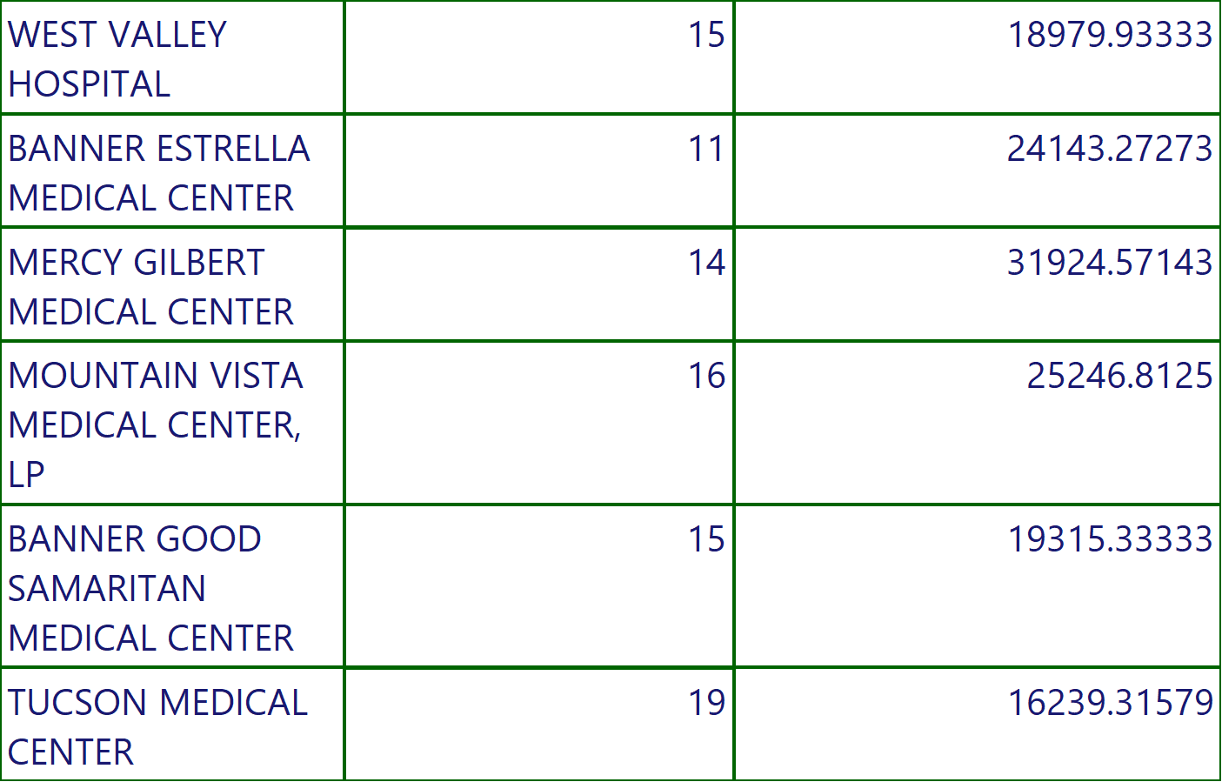
COVID STATE REPORT
Execution Time-10/13/2022 10:31:32 AM
9 of 174

Slide 10
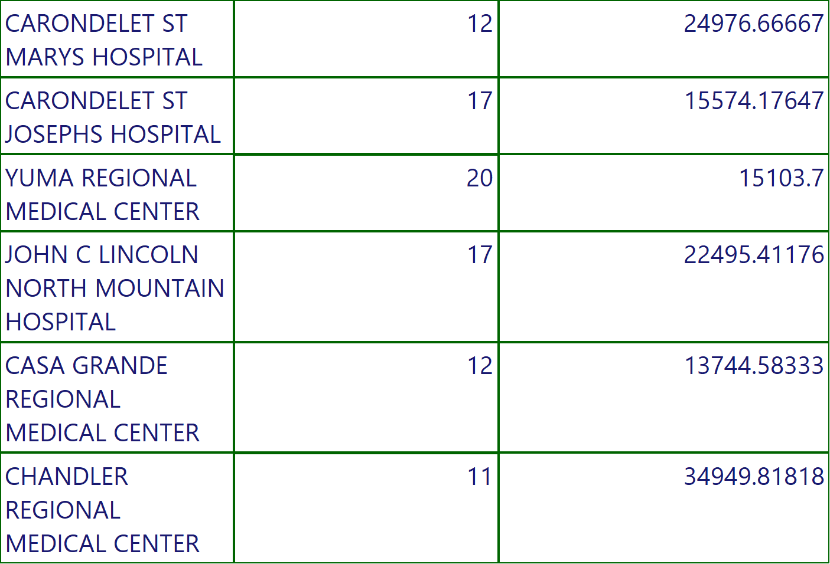
COVID STATE REPORT
Execution Time-10/13/2022 10:31:32 AM
10 of 174

Slide 11
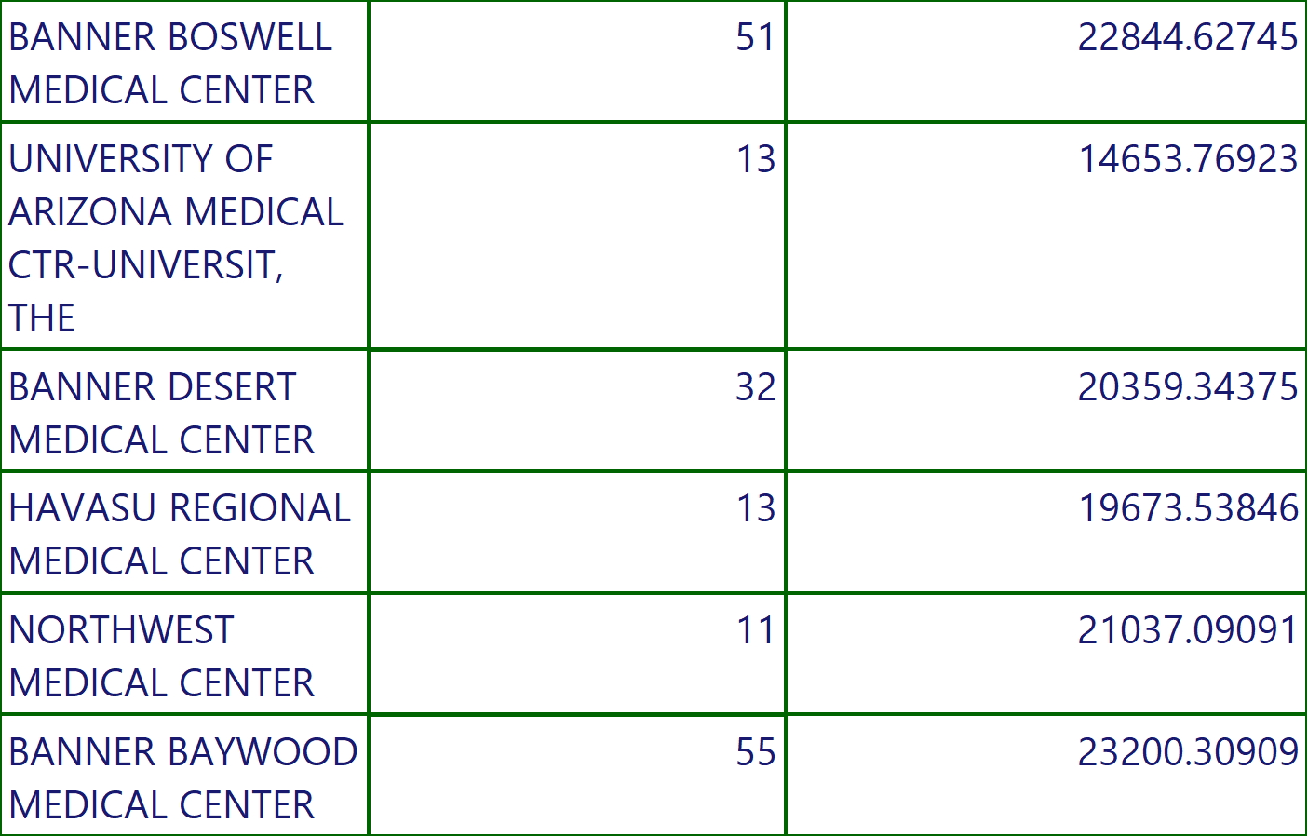
COVID STATE REPORT
Execution Time-10/13/2022 10:31:32 AM
11 of 174

Slide 12
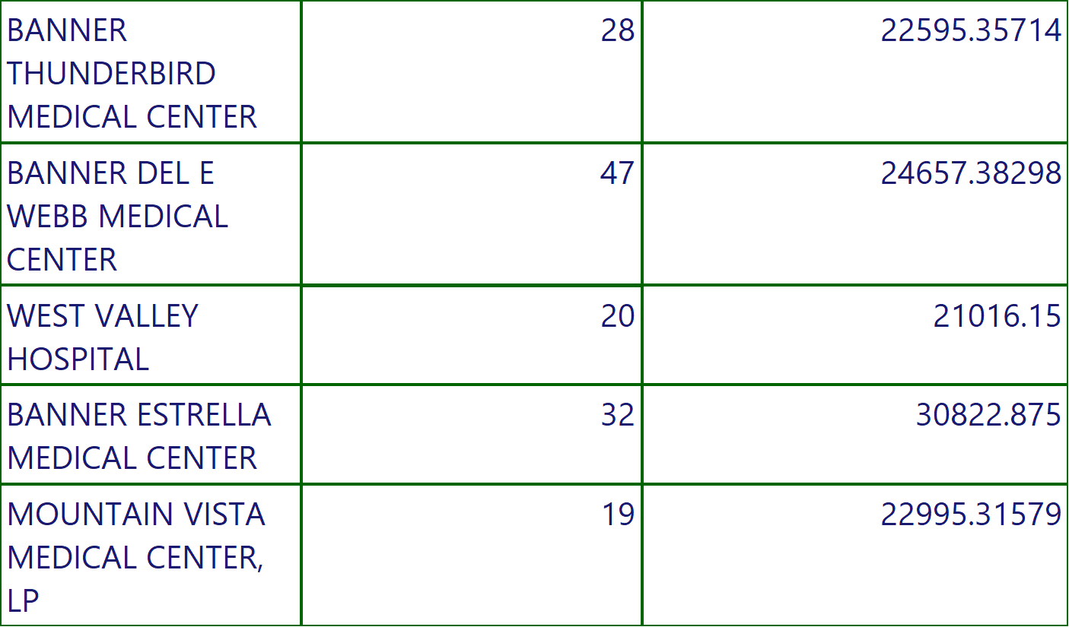
COVID STATE REPORT
Execution Time-10/13/2022 10:31:32 AM
12 of 174

Slide 13
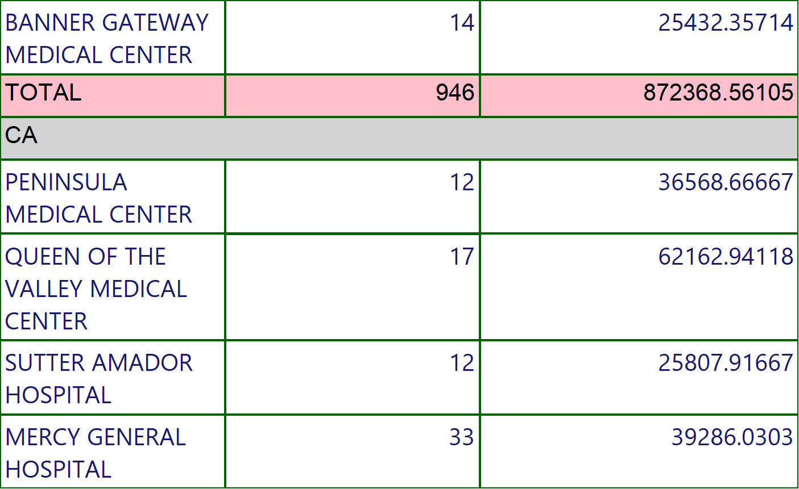
COVID STATE REPORT
Execution Time-10/13/2022 10:31:32 AM
13 of 174

Slide 14
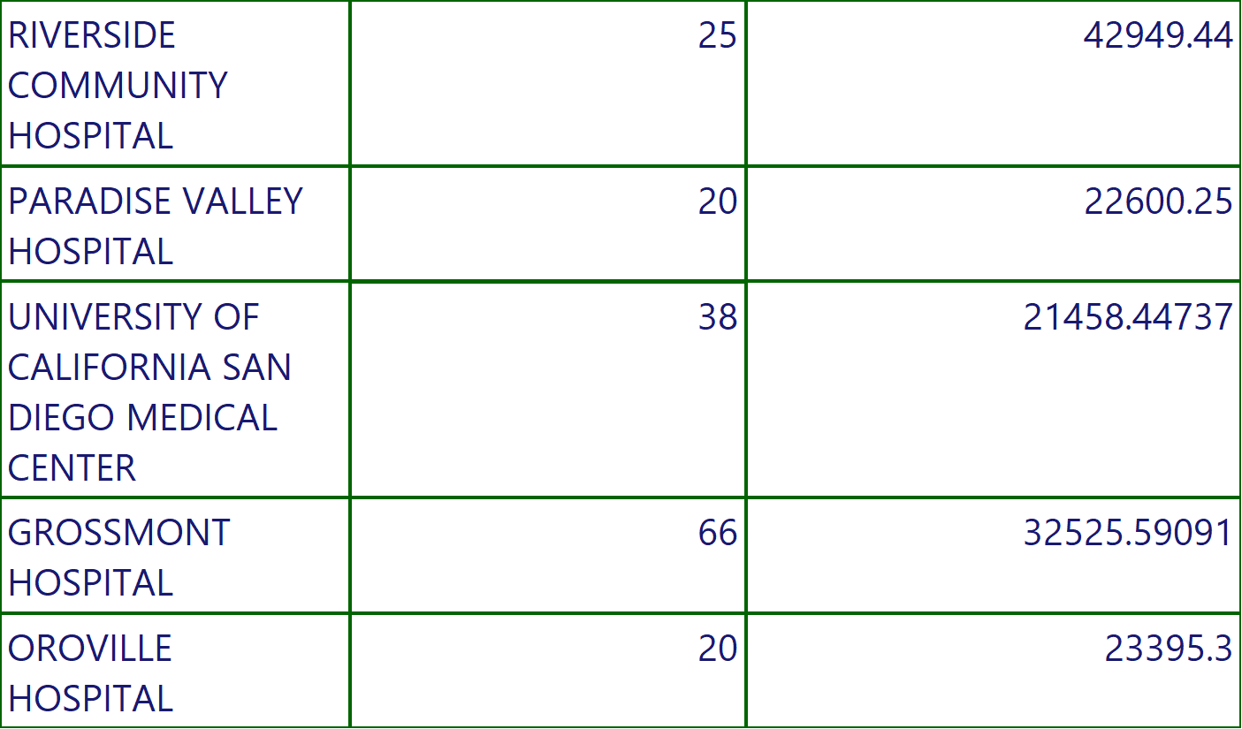
COVID STATE REPORT
Execution Time-10/13/2022 10:31:32 AM
14 of 174

Slide 15
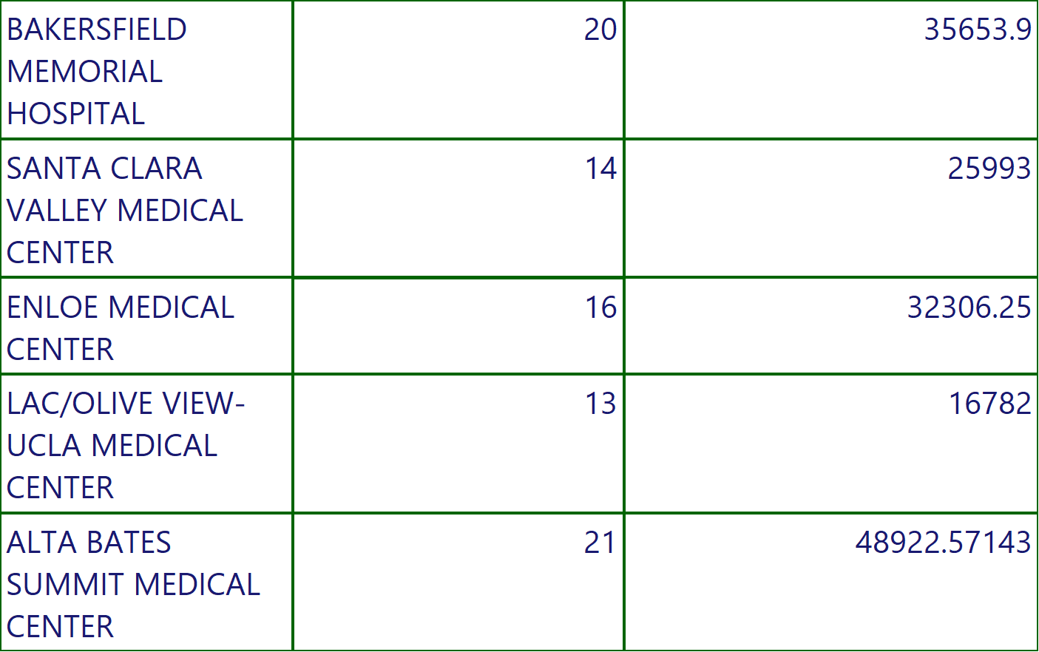
COVID STATE REPORT
Execution Time-10/13/2022 10:31:32 AM
15 of 174

Slide 16
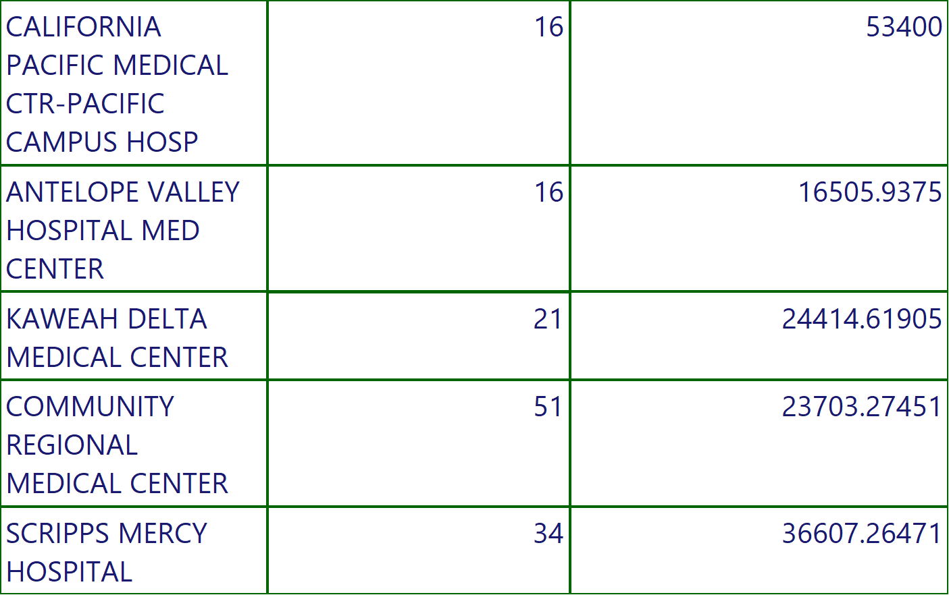
COVID STATE REPORT
Execution Time-10/13/2022 10:31:32 AM
16 of 174

Slide 17
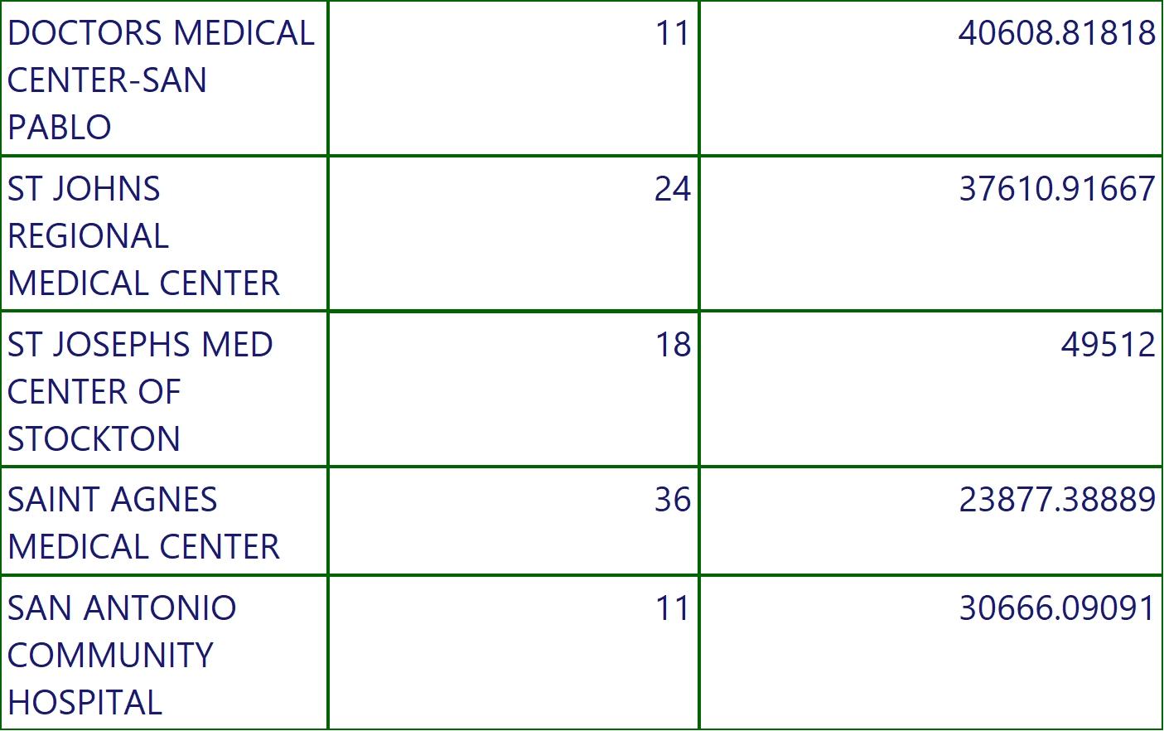
COVID STATE REPORT
Execution Time-10/13/2022 10:31:32 AM
17 of 174

Slide 18
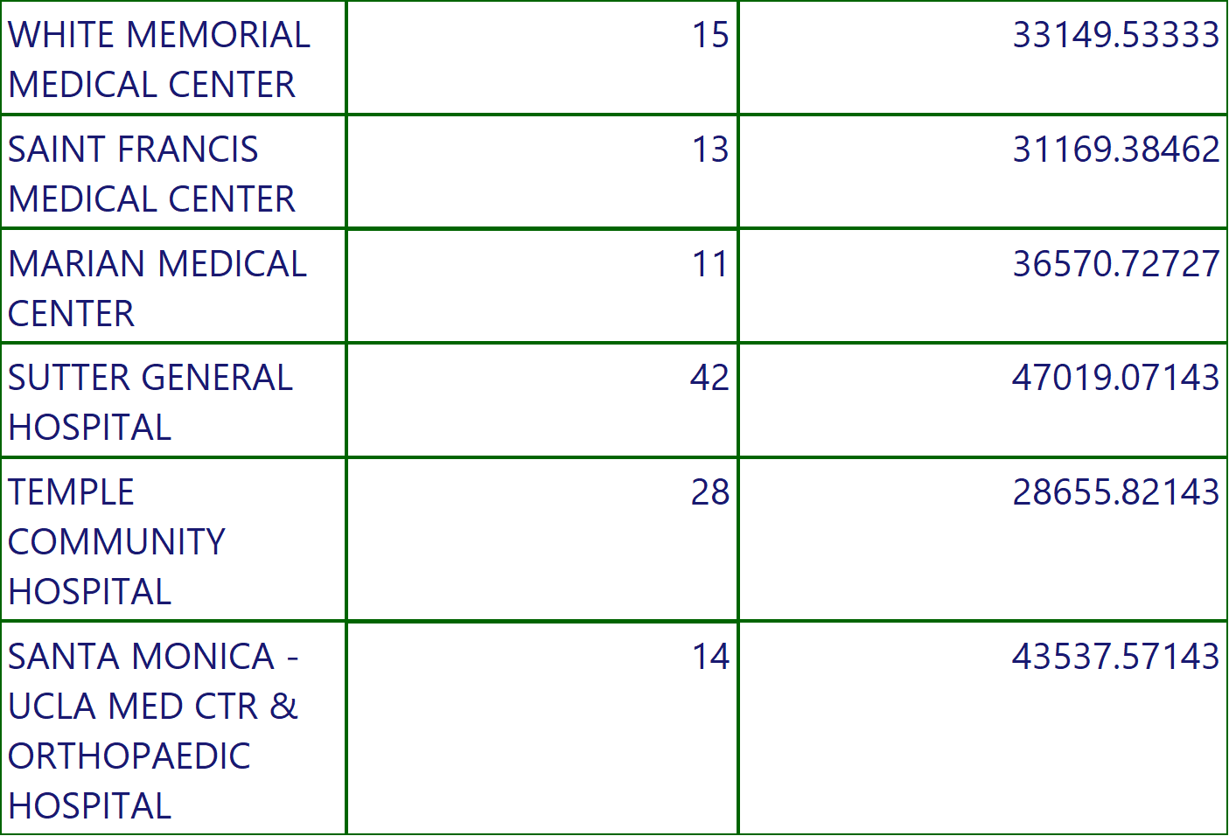
COVID STATE REPORT
Execution Time-10/13/2022 10:31:32 AM
18 of 174

Slide 19
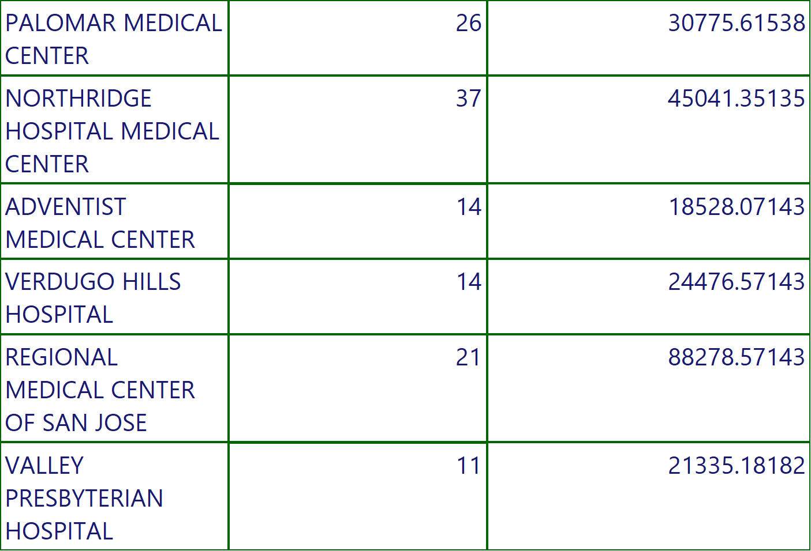
COVID STATE REPORT
Execution Time-10/13/2022 10:31:32 AM
19 of 174

Slide 20
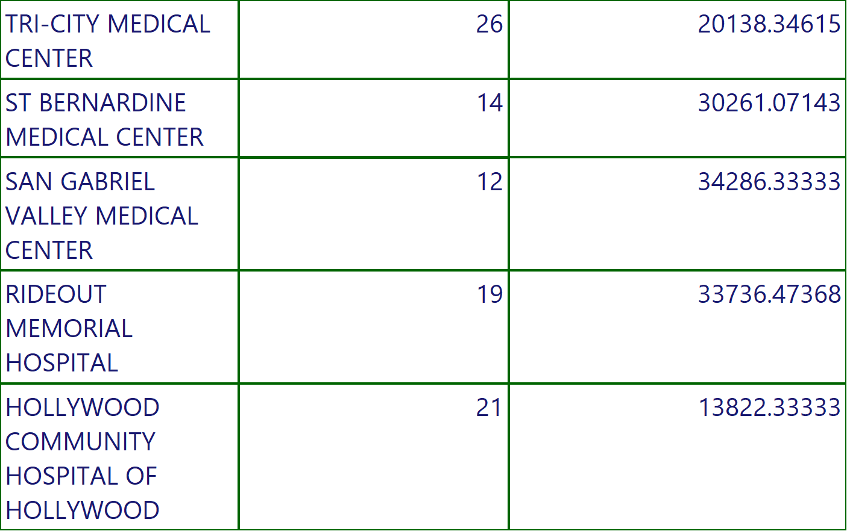
COVID STATE REPORT
Execution Time-10/13/2022 10:31:32 AM
20 of 174

Slide 21
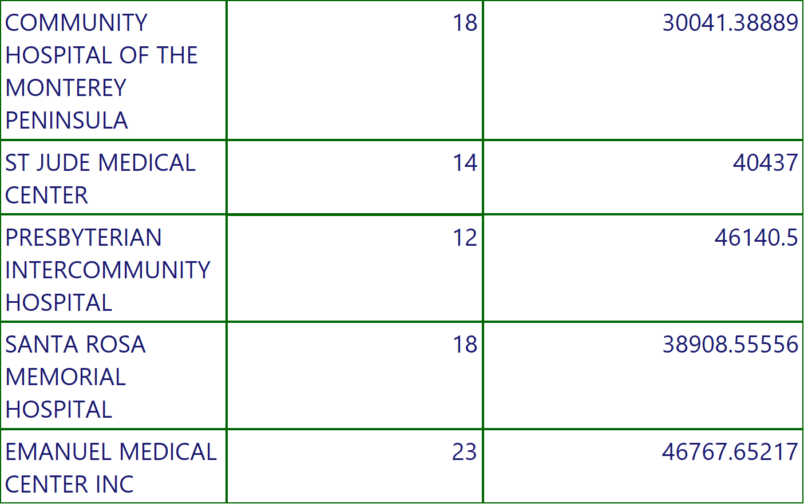
COVID STATE REPORT
Execution Time-10/13/2022 10:31:32 AM
21 of 174

Slide 22
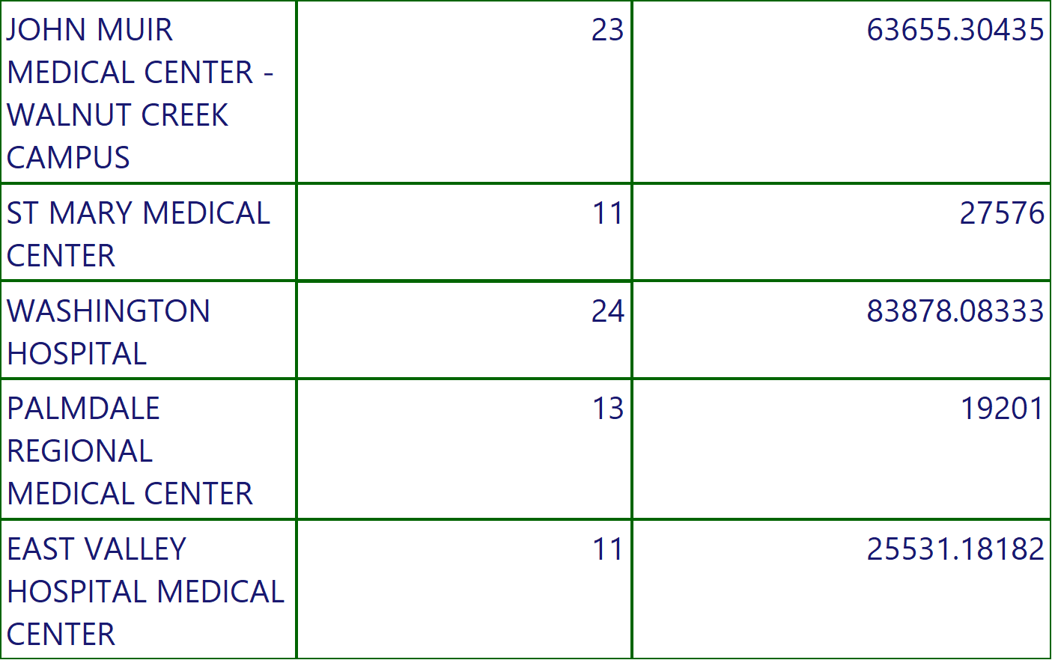
COVID STATE REPORT
Execution Time-10/13/2022 10:31:32 AM
22 of 174

Slide 23
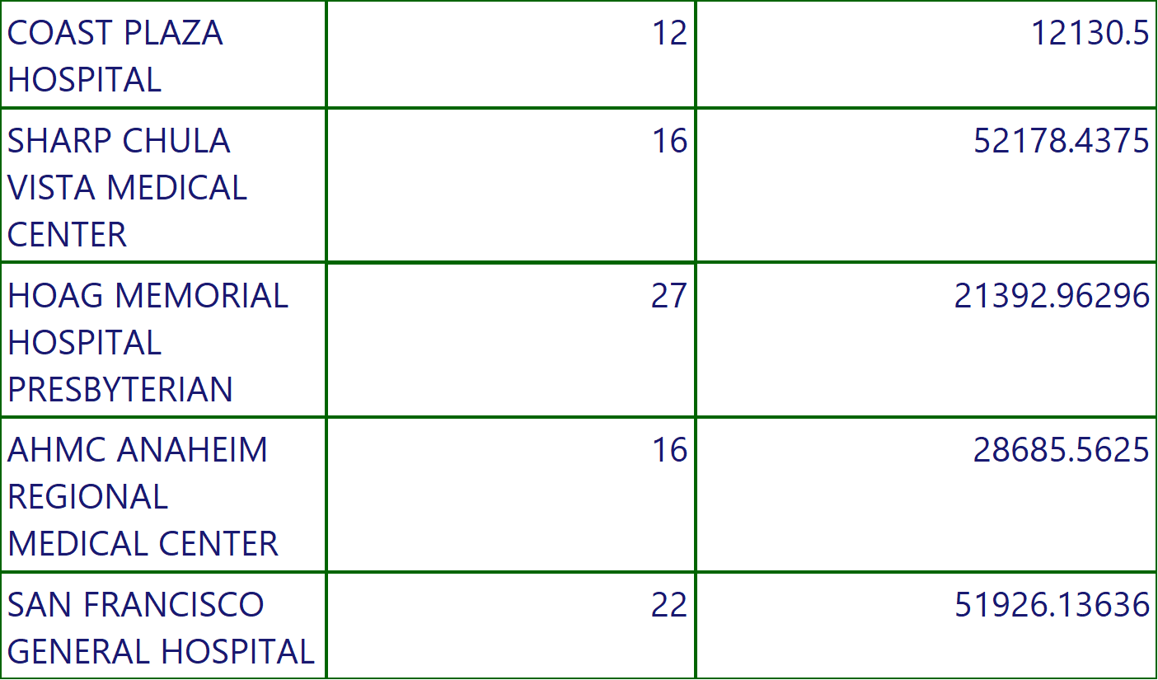
COVID STATE REPORT
Execution Time-10/13/2022 10:31:32 AM
23 of 174

Slide 24
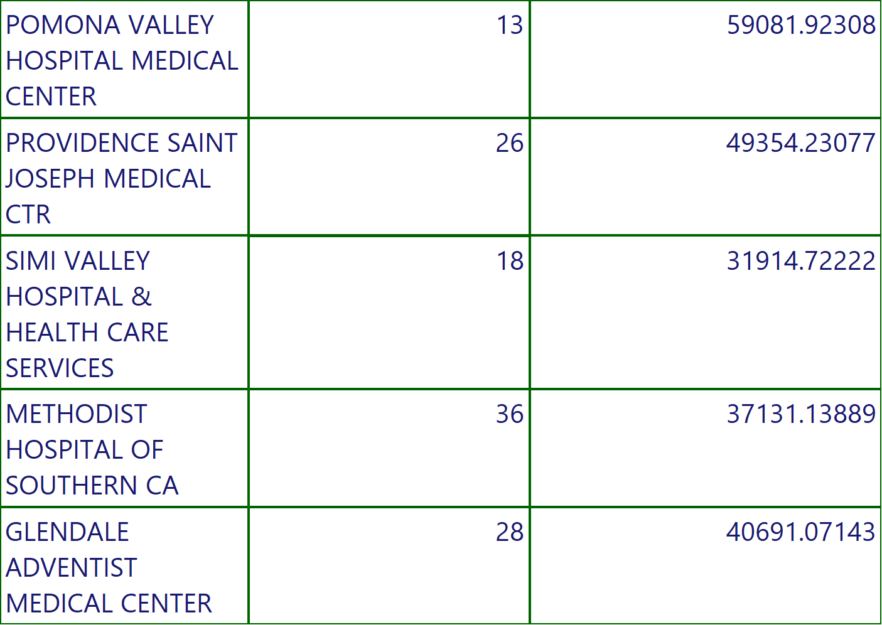
COVID STATE REPORT
Execution Time-10/13/2022 10:31:32 AM
24 of 174

Slide 25
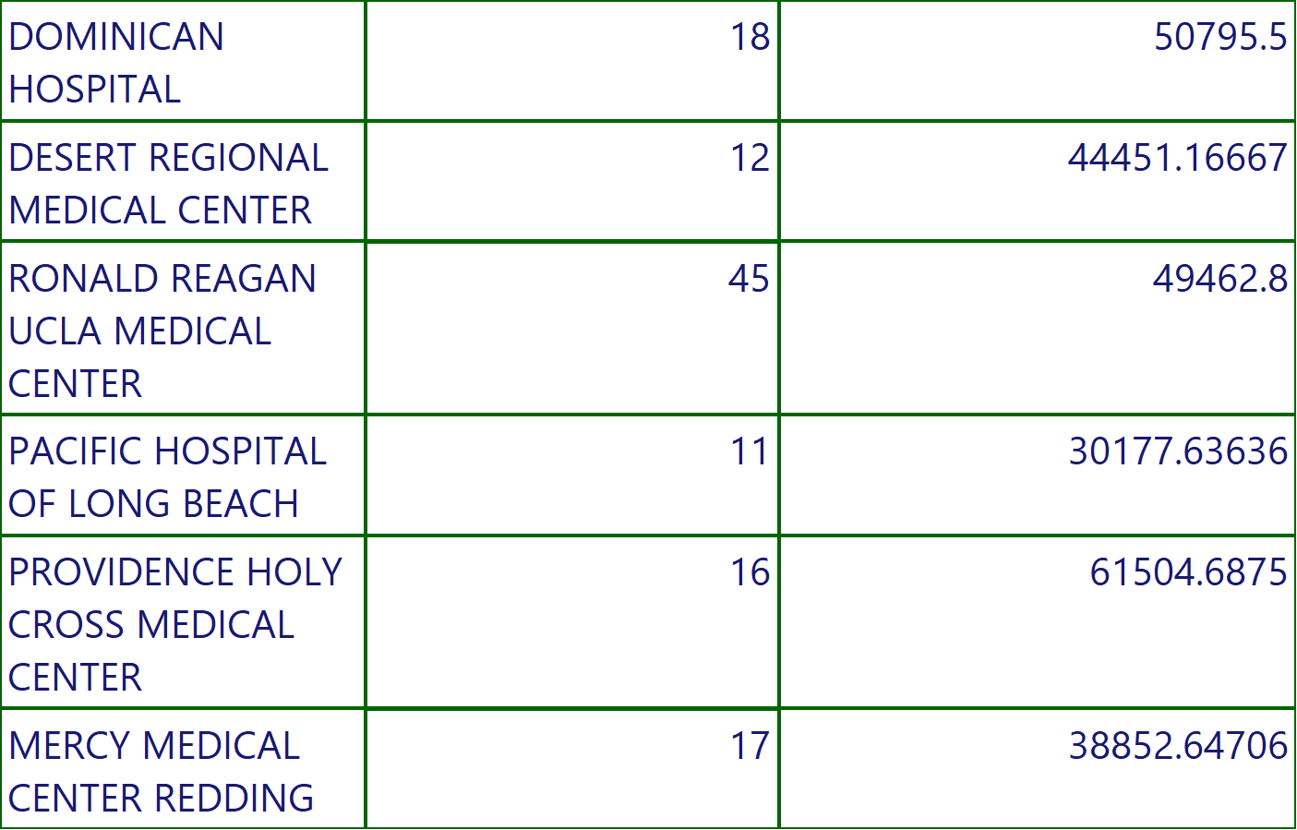
COVID STATE REPORT
Execution Time-10/13/2022 10:31:32 AM
25 of 174

Slide 26
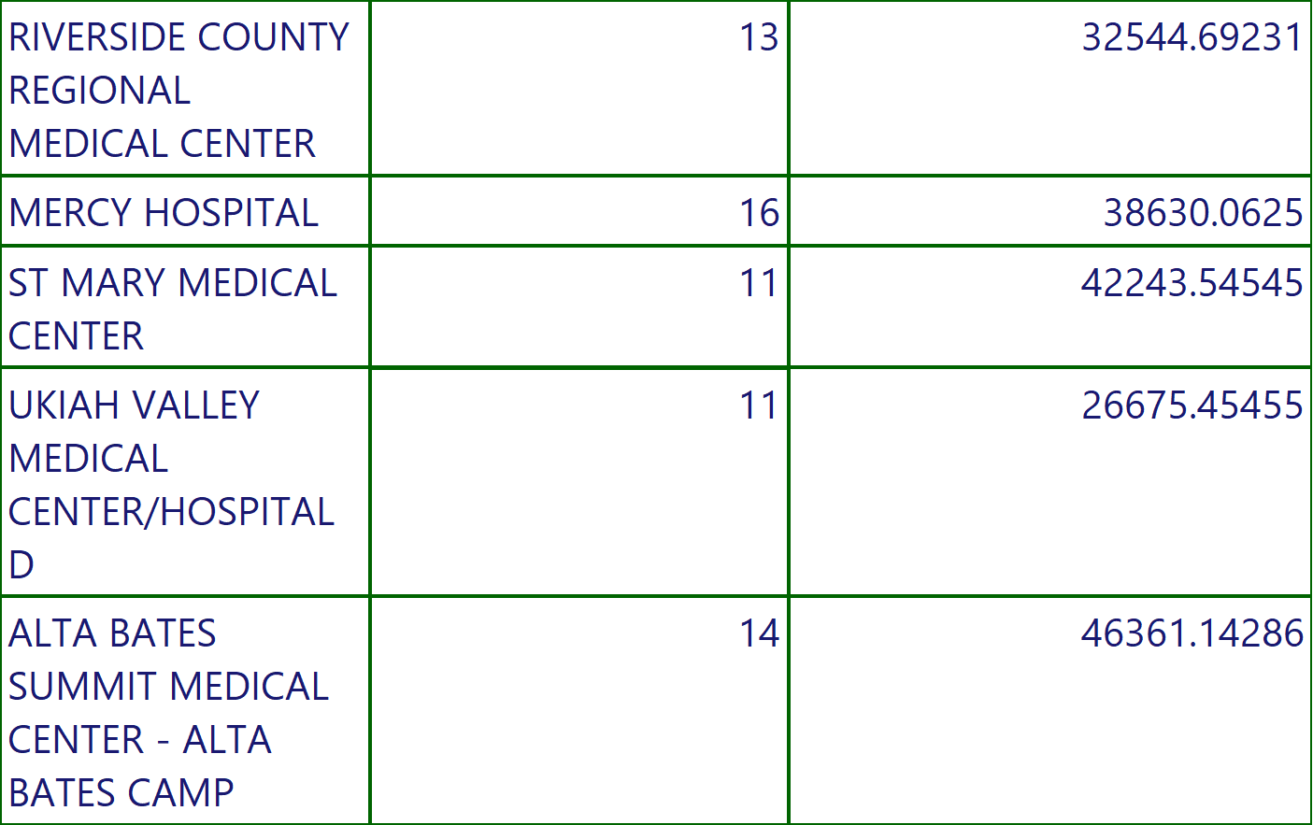
COVID STATE REPORT
Execution Time-10/13/2022 10:31:32 AM
26 of 174

Slide 27
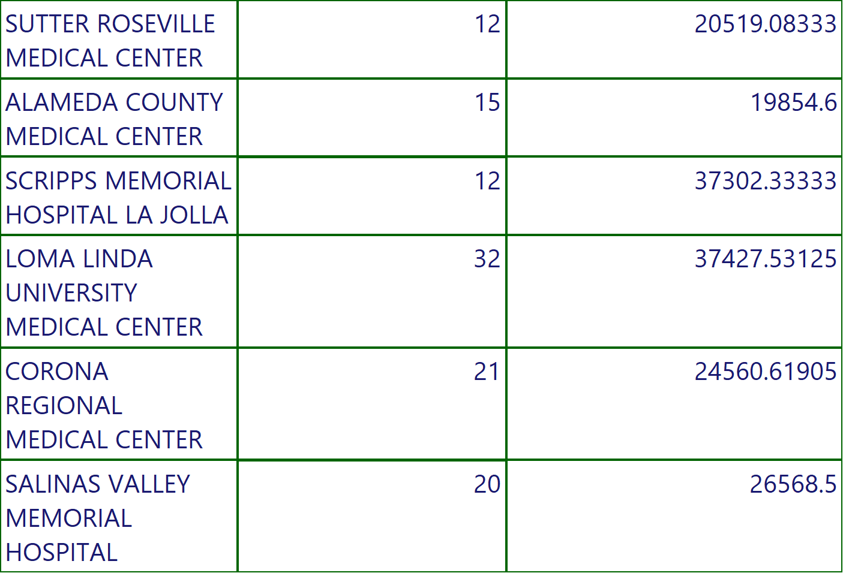
COVID STATE REPORT
Execution Time-10/13/2022 10:31:32 AM
27 of 174

Slide 28
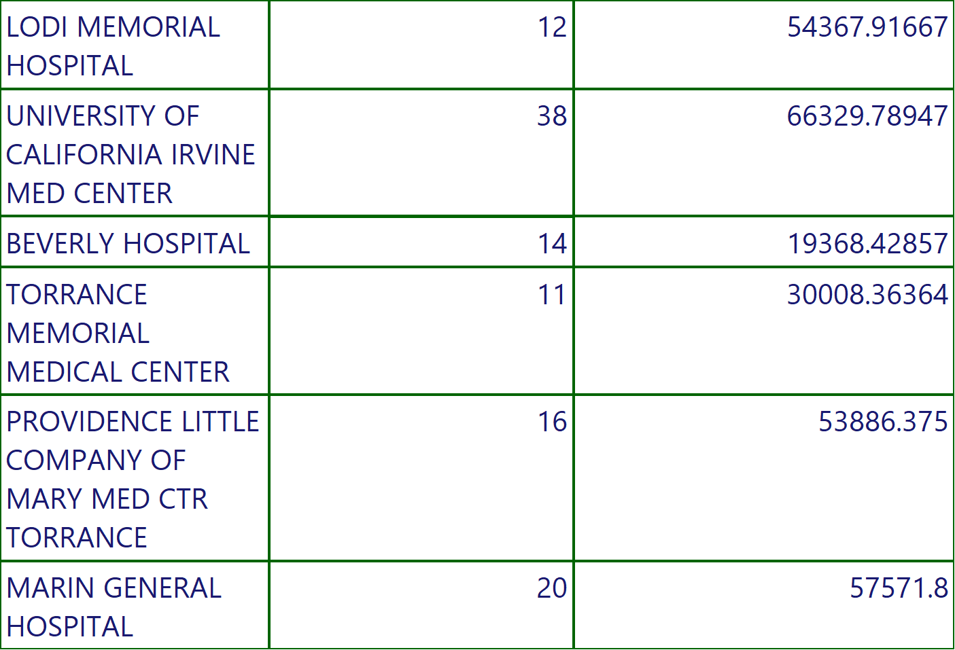
COVID STATE REPORT
Execution Time-10/13/2022 10:31:32 AM
28 of 174

Slide 29
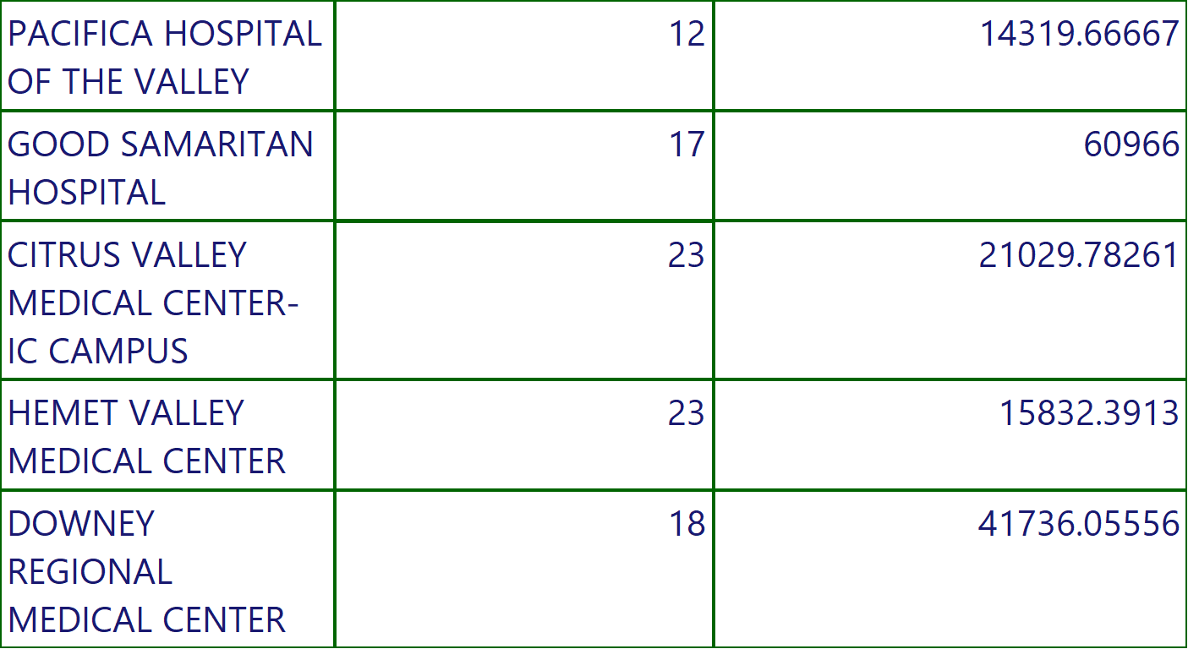
COVID STATE REPORT
Execution Time-10/13/2022 10:31:32 AM
29 of 174

Slide 30
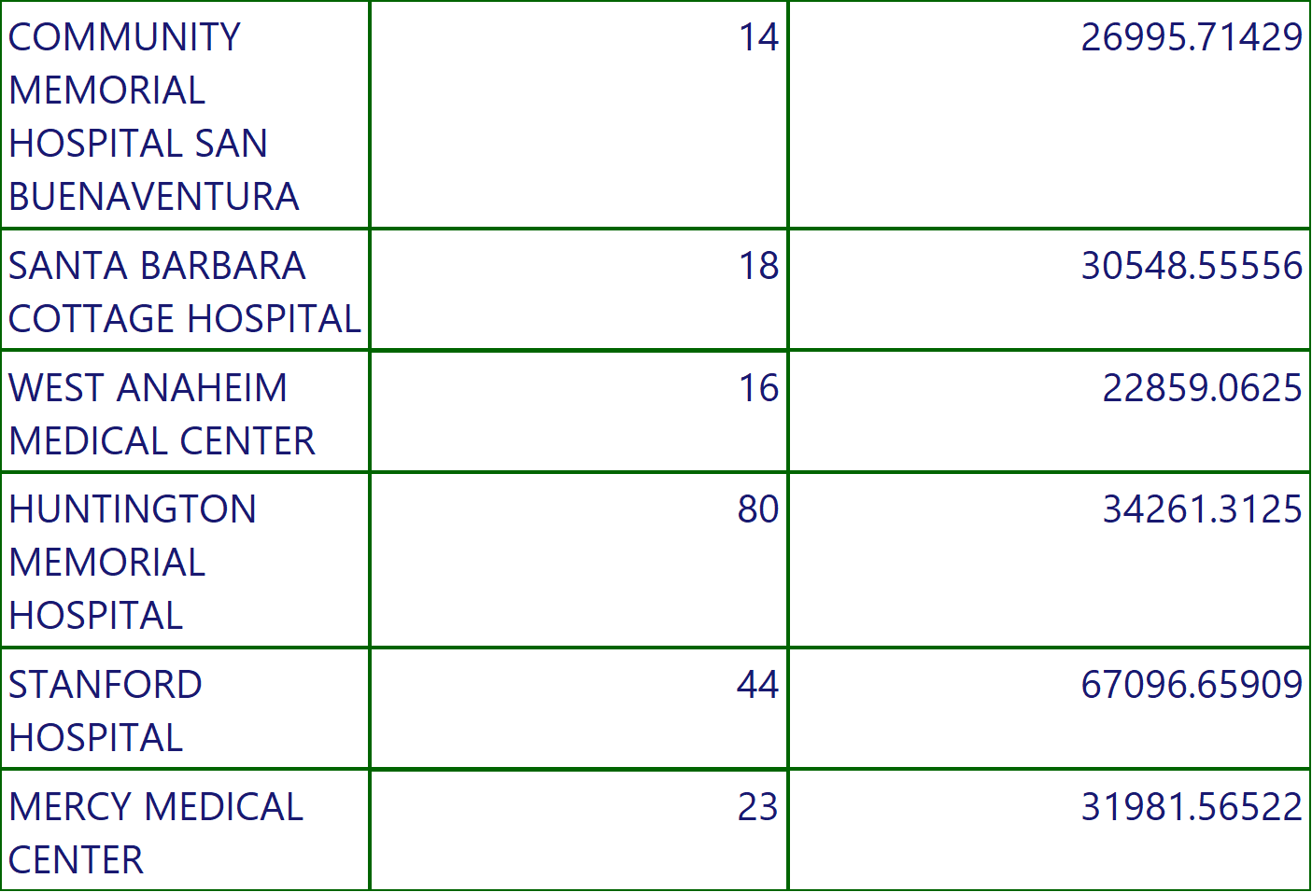
COVID STATE REPORT
Execution Time-10/13/2022 10:31:32 AM
30 of 174

Slide 31
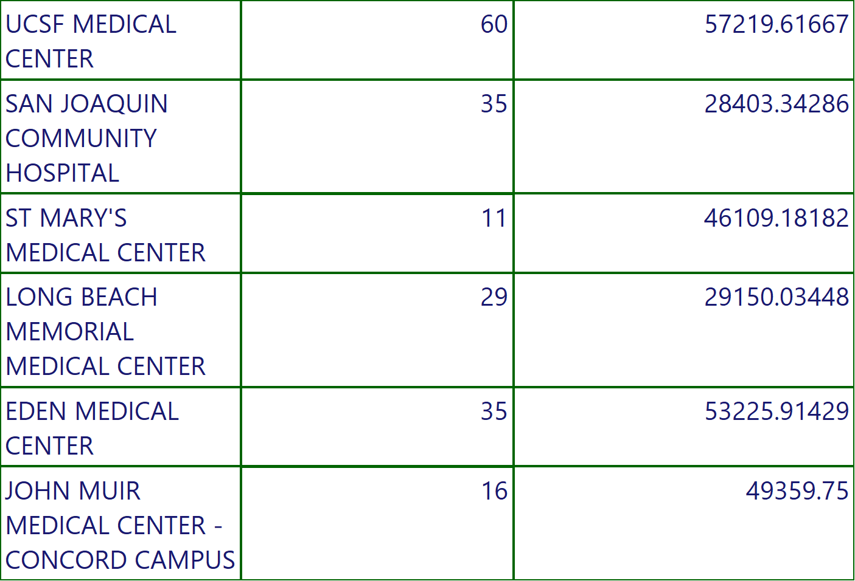
COVID STATE REPORT
Execution Time-10/13/2022 10:31:32 AM
31 of 174

Slide 32
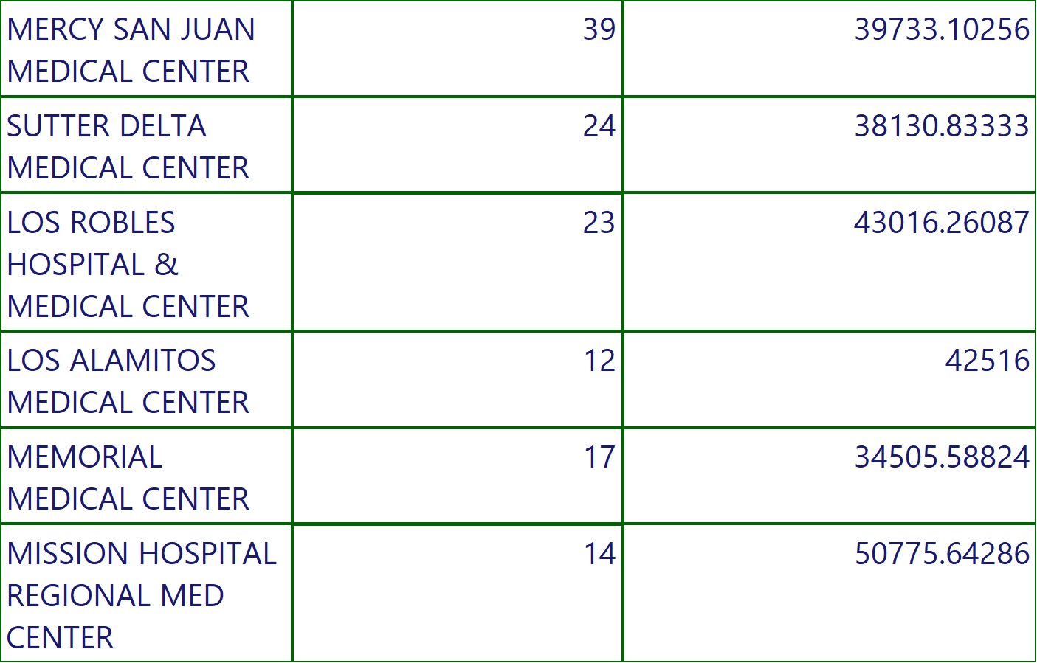
COVID STATE REPORT
Execution Time-10/13/2022 10:31:32 AM
32 of 174

Slide 33
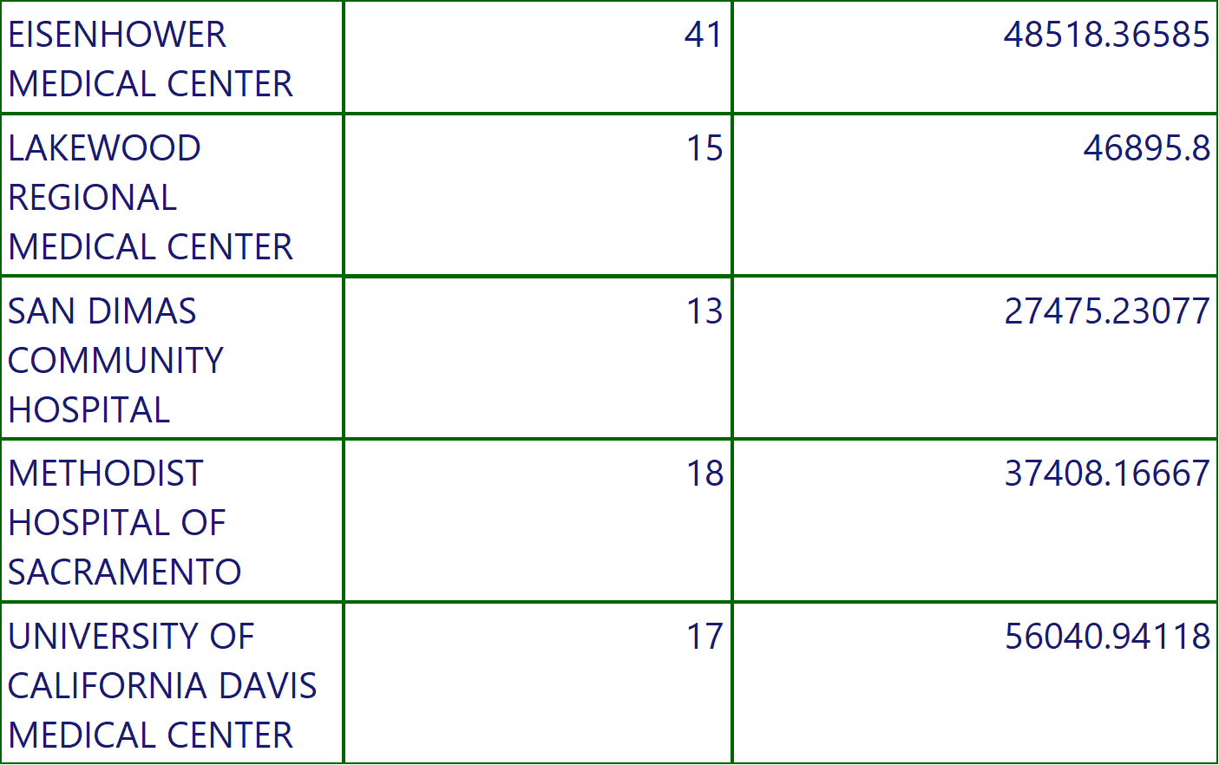
COVID STATE REPORT
Execution Time-10/13/2022 10:31:32 AM
33 of 174

Slide 34
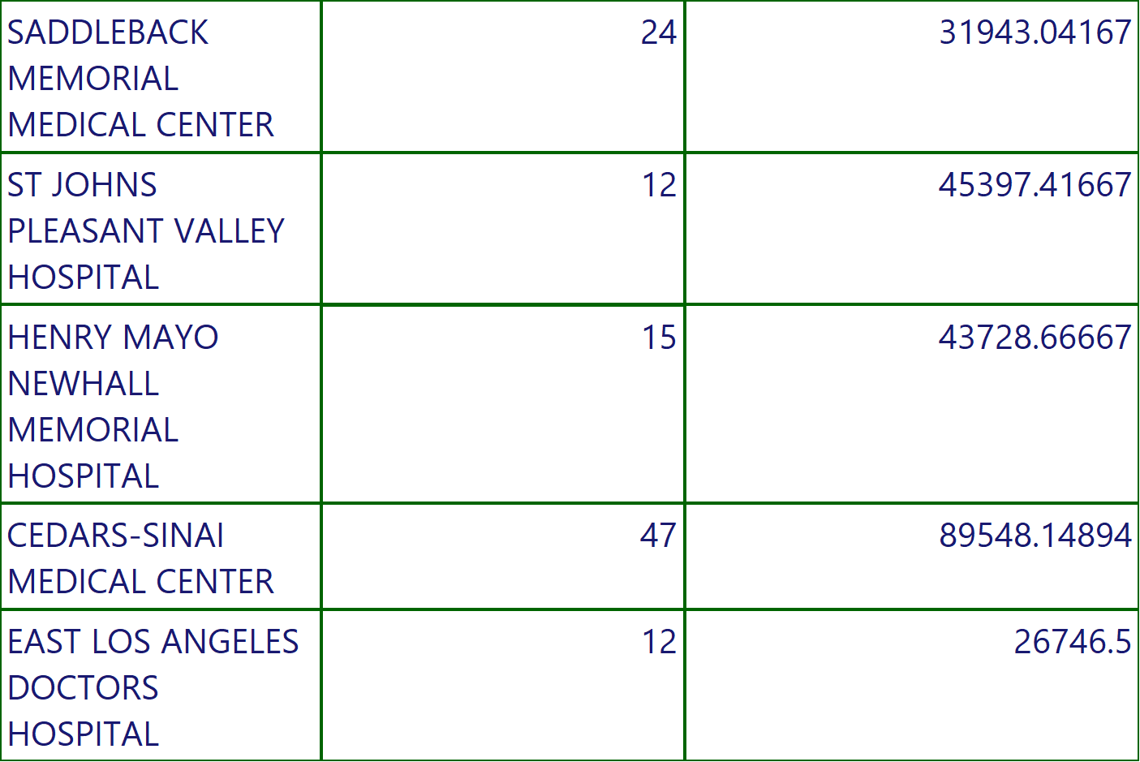
COVID STATE REPORT
Execution Time-10/13/2022 10:31:32 AM
34 of 174

Slide 35
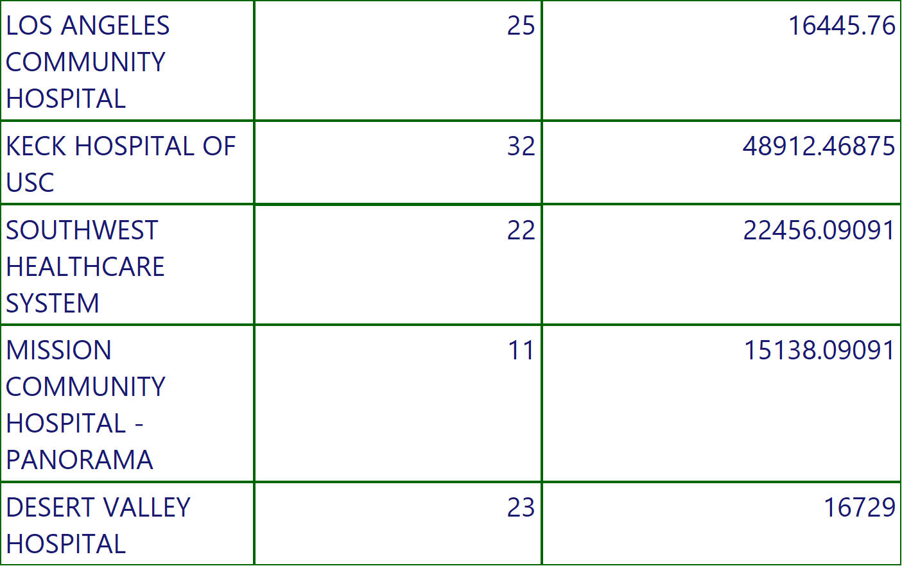
COVID STATE REPORT
Execution Time-10/13/2022 10:31:32 AM
35 of 174

Slide 36
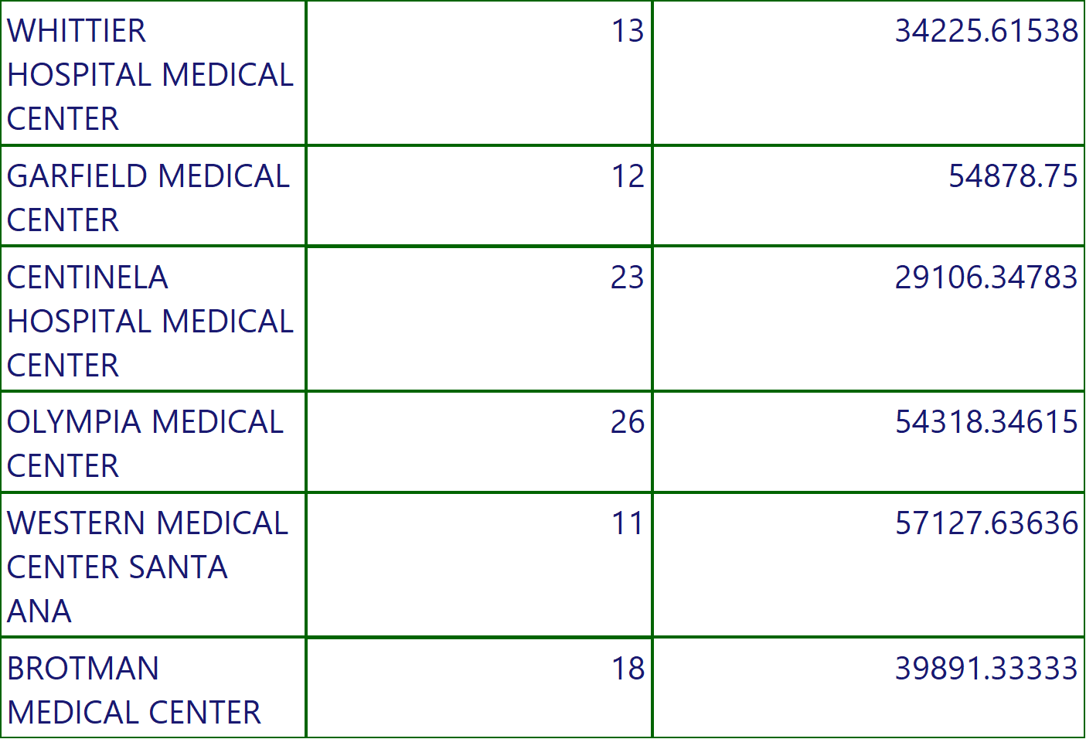
COVID STATE REPORT
Execution Time-10/13/2022 10:31:32 AM
36 of 174

Slide 37
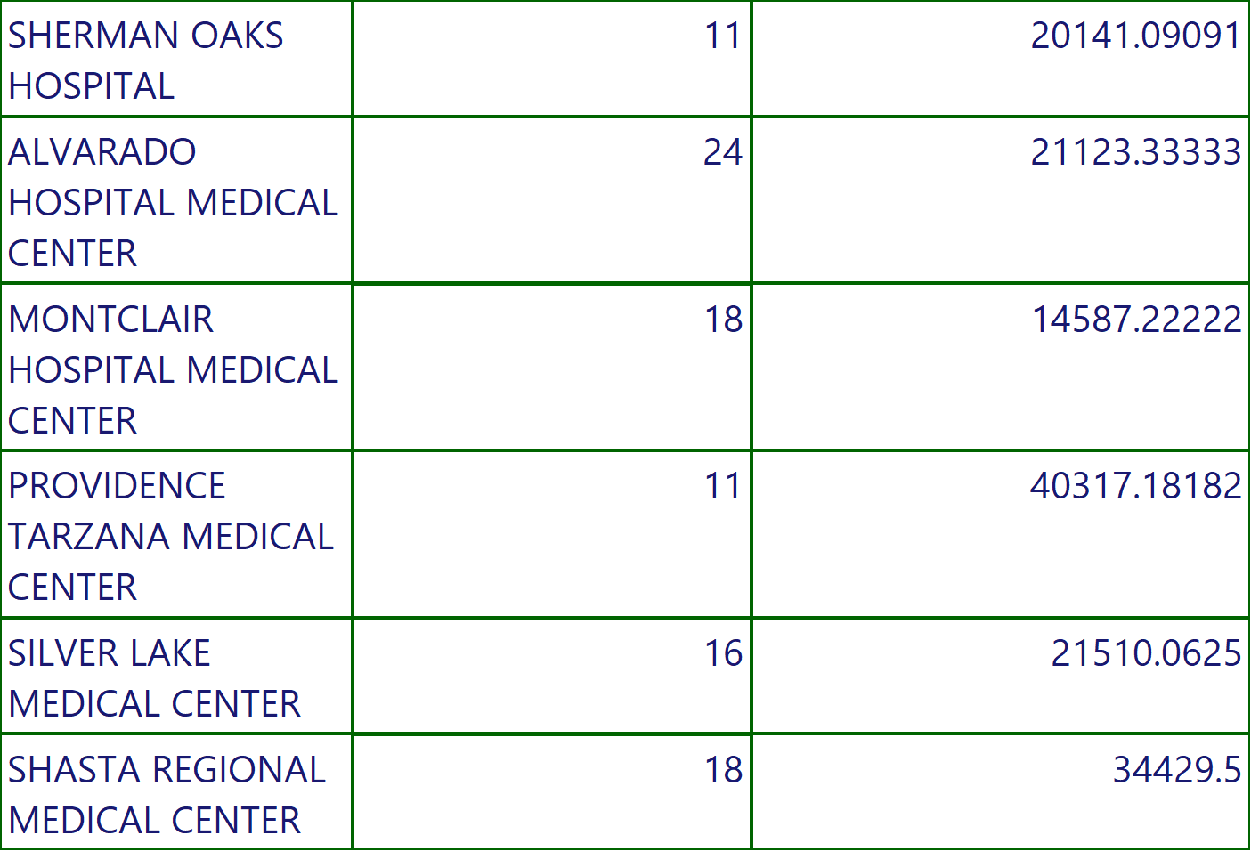
COVID STATE REPORT
Execution Time-10/13/2022 10:31:32 AM
37 of 174

Slide 38
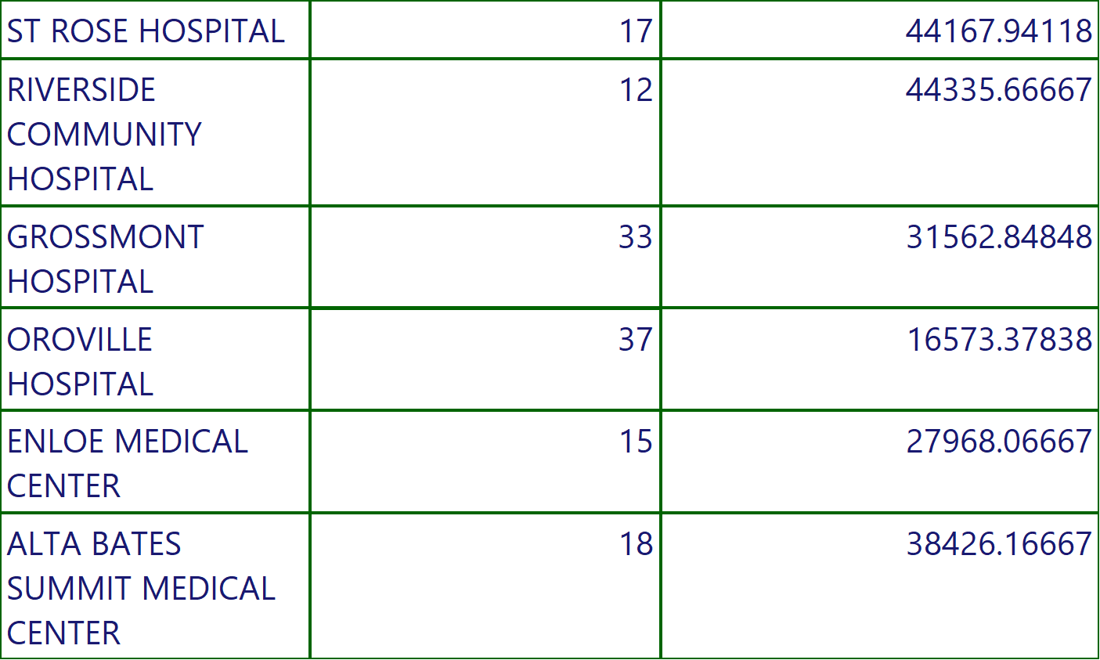
COVID STATE REPORT
Execution Time-10/13/2022 10:31:32 AM
38 of 174

Slide 39
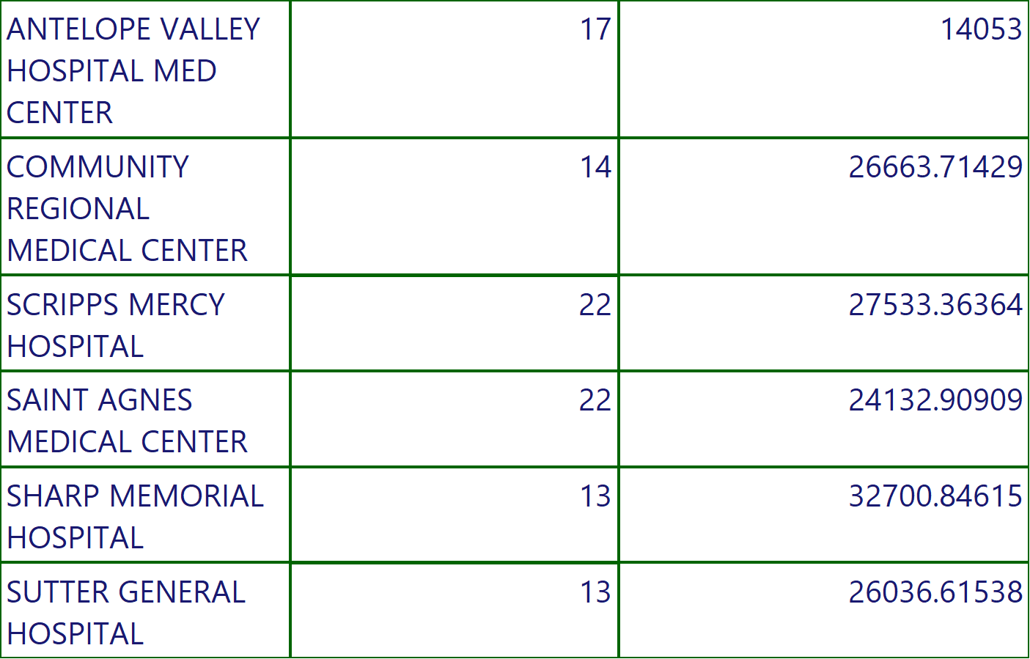
COVID STATE REPORT
Execution Time-10/13/2022 10:31:32 AM
39 of 174

Slide 40
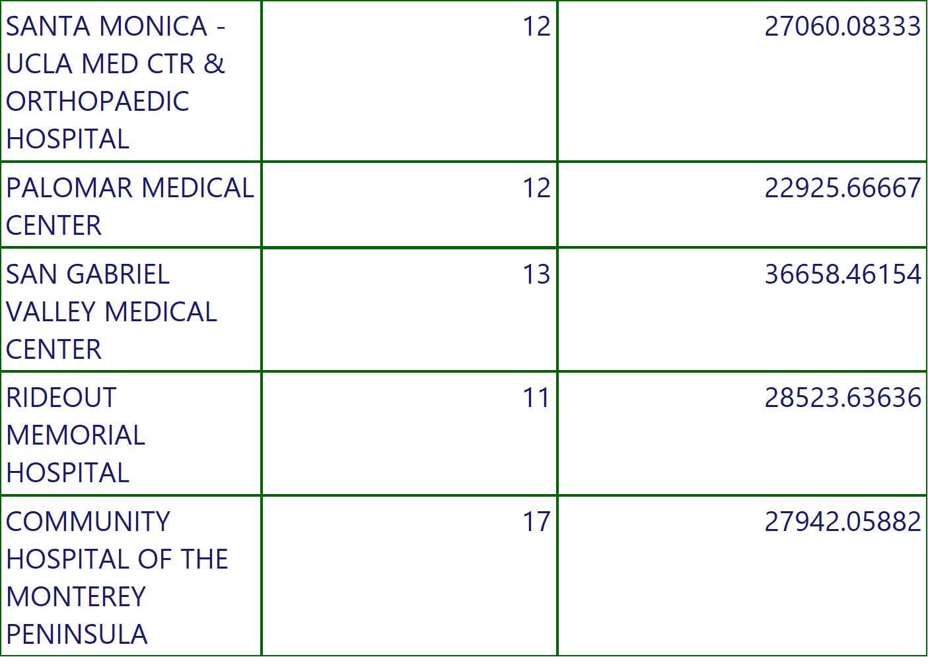
COVID STATE REPORT
Execution Time-10/13/2022 10:31:32 AM
40 of 174

Slide 41
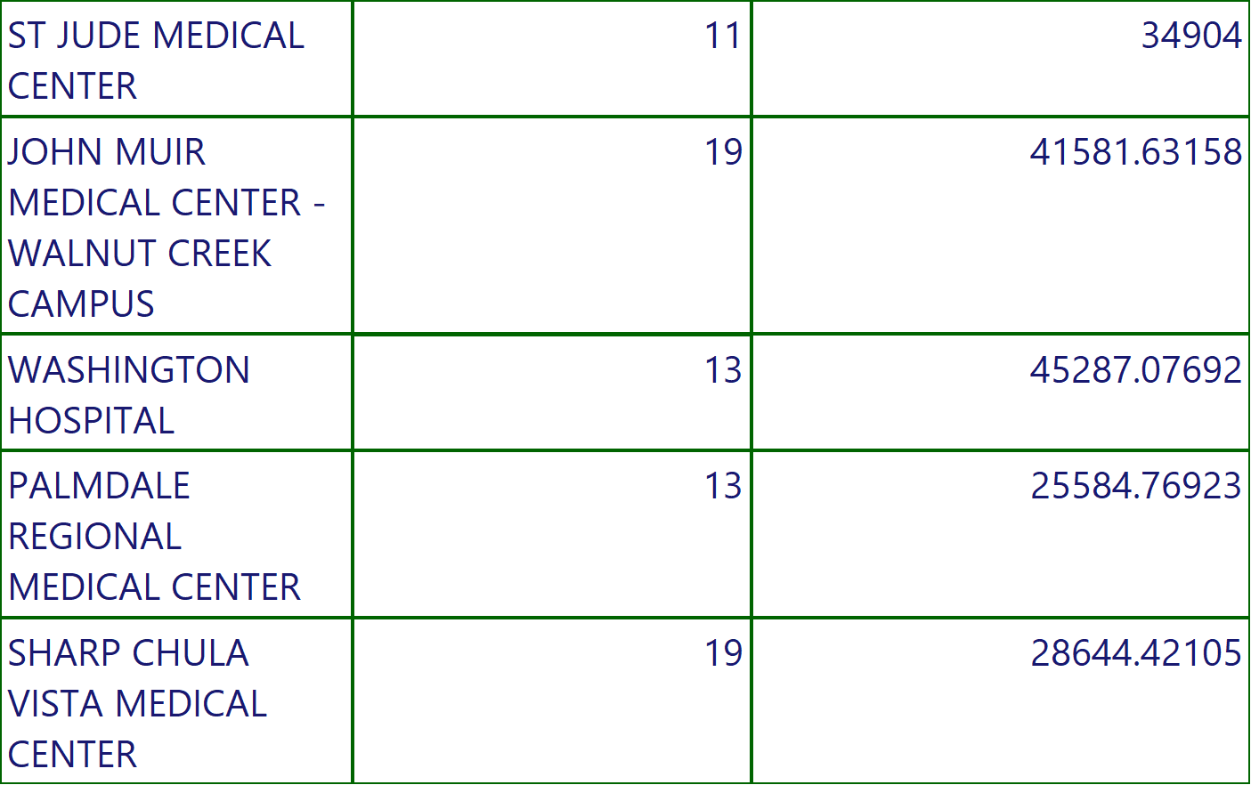
COVID STATE REPORT
Execution Time-10/13/2022 10:31:32 AM
41 of 174

Slide 42
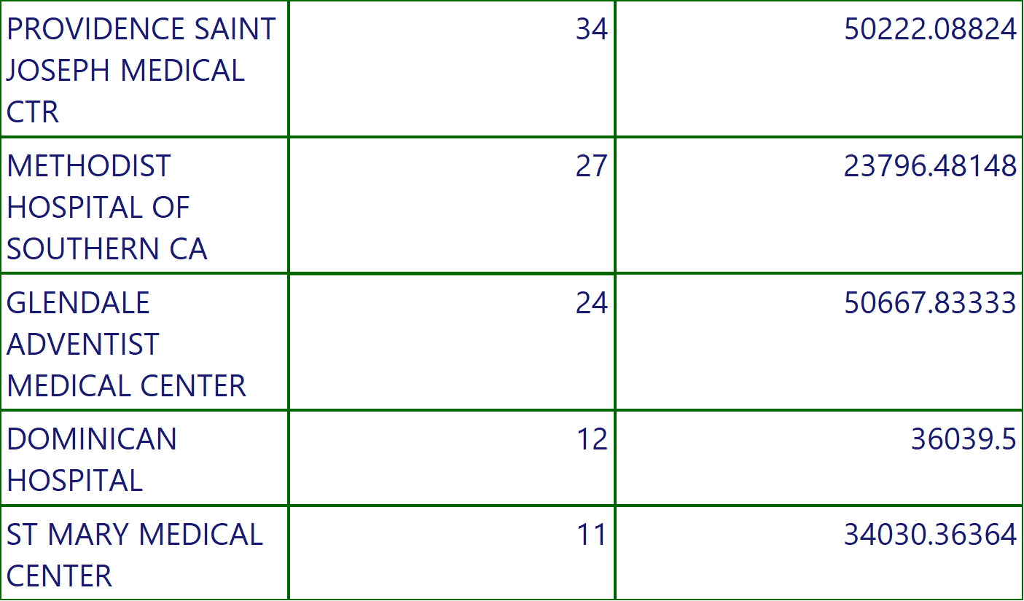
COVID STATE REPORT
Execution Time-10/13/2022 10:31:32 AM
42 of 174

Slide 43
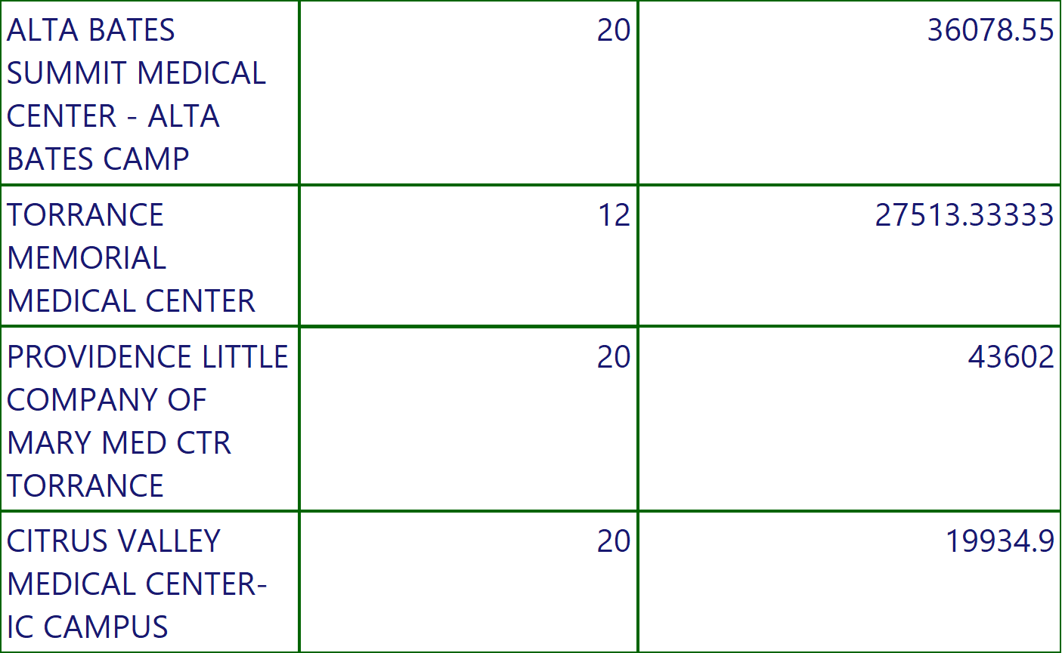
COVID STATE REPORT
Execution Time-10/13/2022 10:31:32 AM
43 of 174

Slide 44
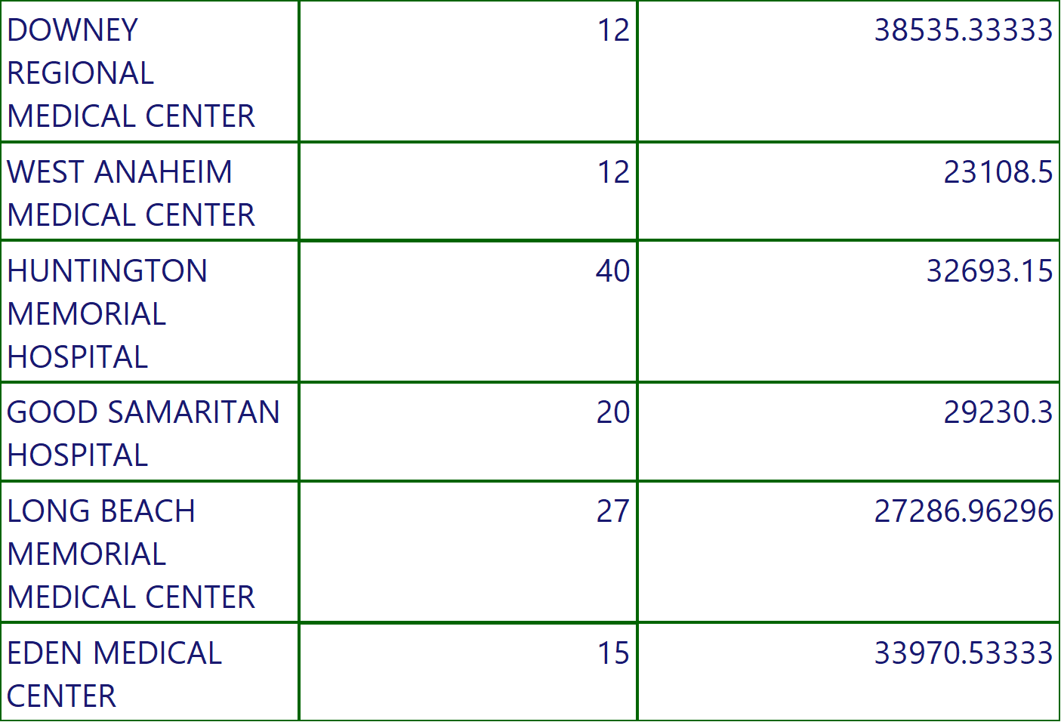
COVID STATE REPORT
Execution Time-10/13/2022 10:31:32 AM
44 of 174

Slide 45
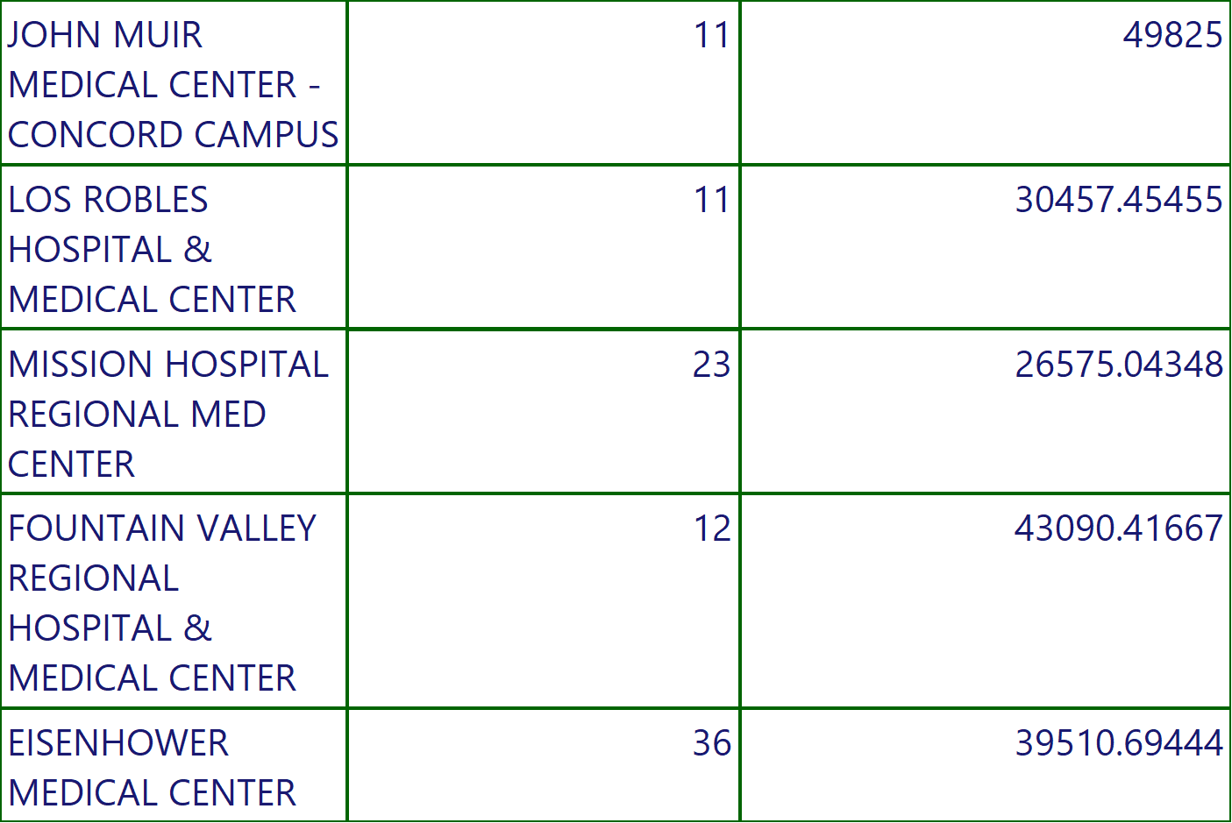
COVID STATE REPORT
Execution Time-10/13/2022 10:31:32 AM
45 of 174

Slide 46
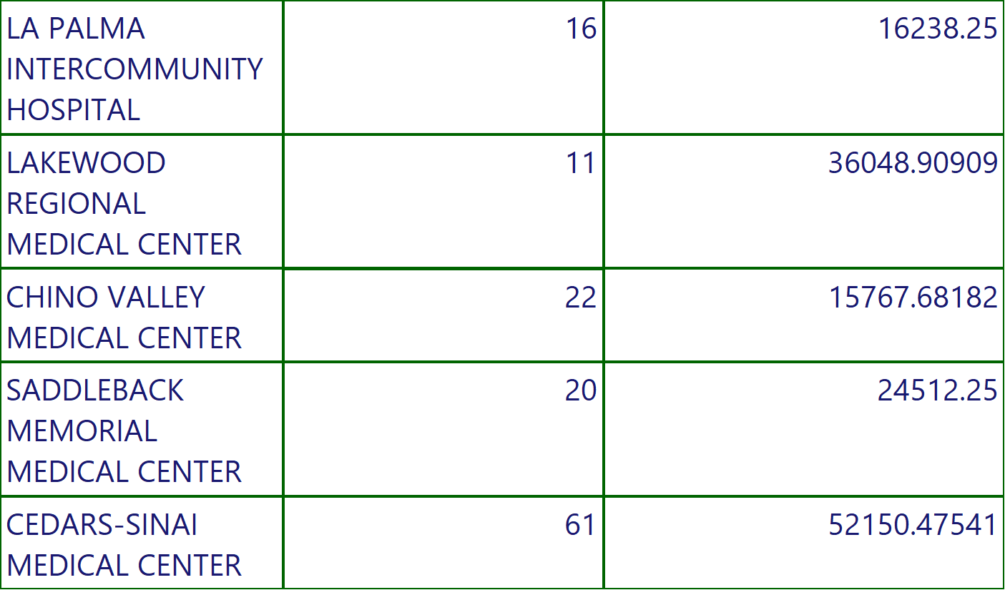
COVID STATE REPORT
Execution Time-10/13/2022 10:31:32 AM
46 of 174

Slide 47
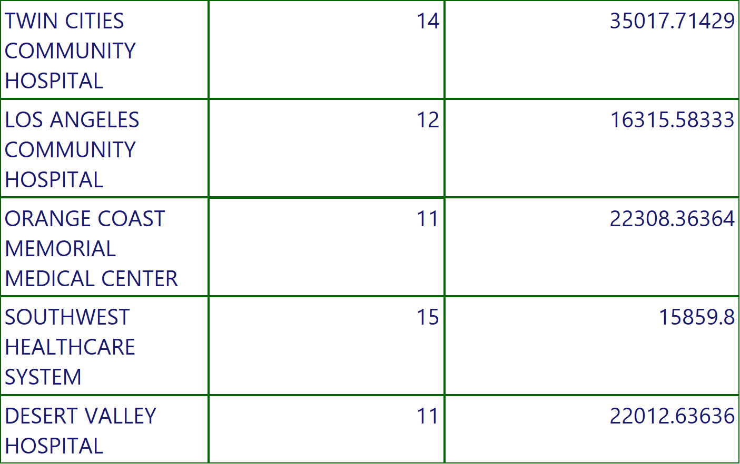
COVID STATE REPORT
Execution Time-10/13/2022 10:31:32 AM
47 of 174

Slide 48
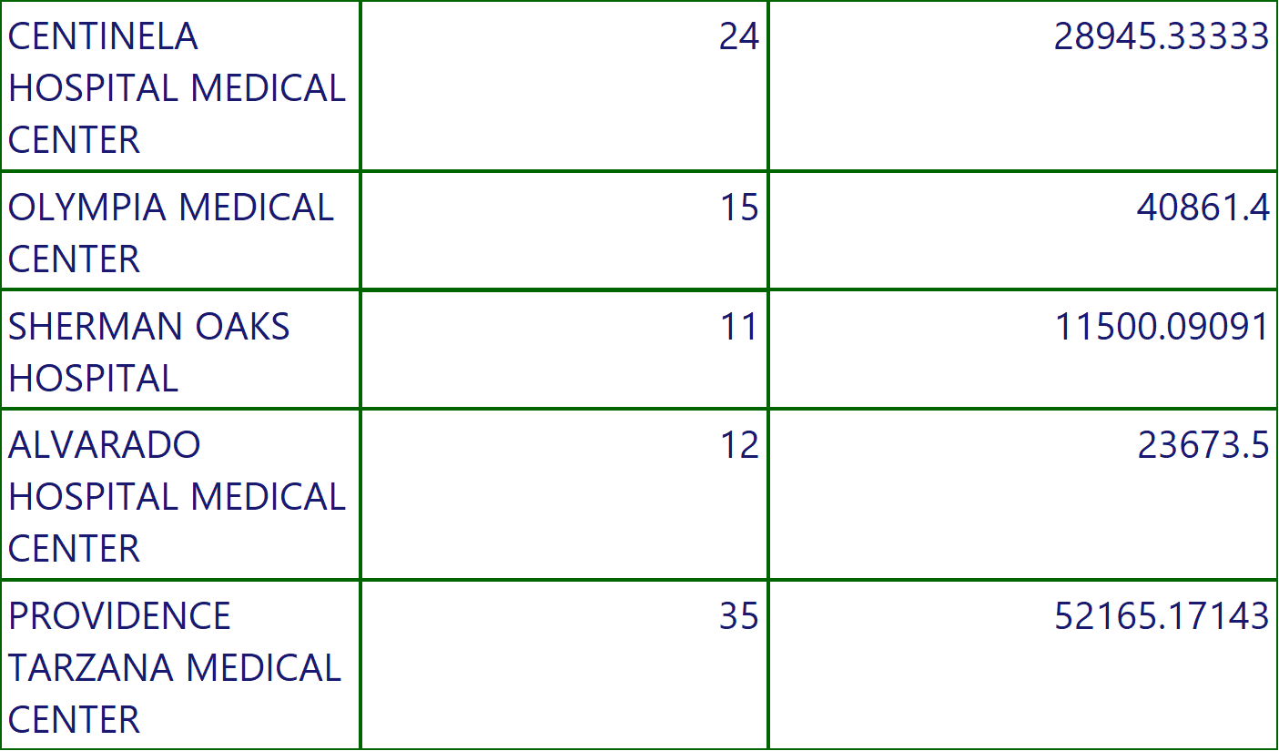
COVID STATE REPORT
Execution Time-10/13/2022 10:31:32 AM
48 of 174

Slide 49
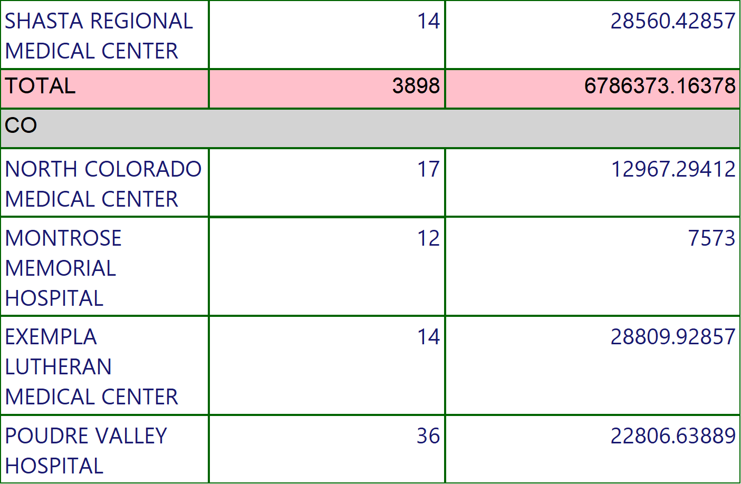
COVID STATE REPORT
Execution Time-10/13/2022 10:31:32 AM
49 of 174

Slide 50
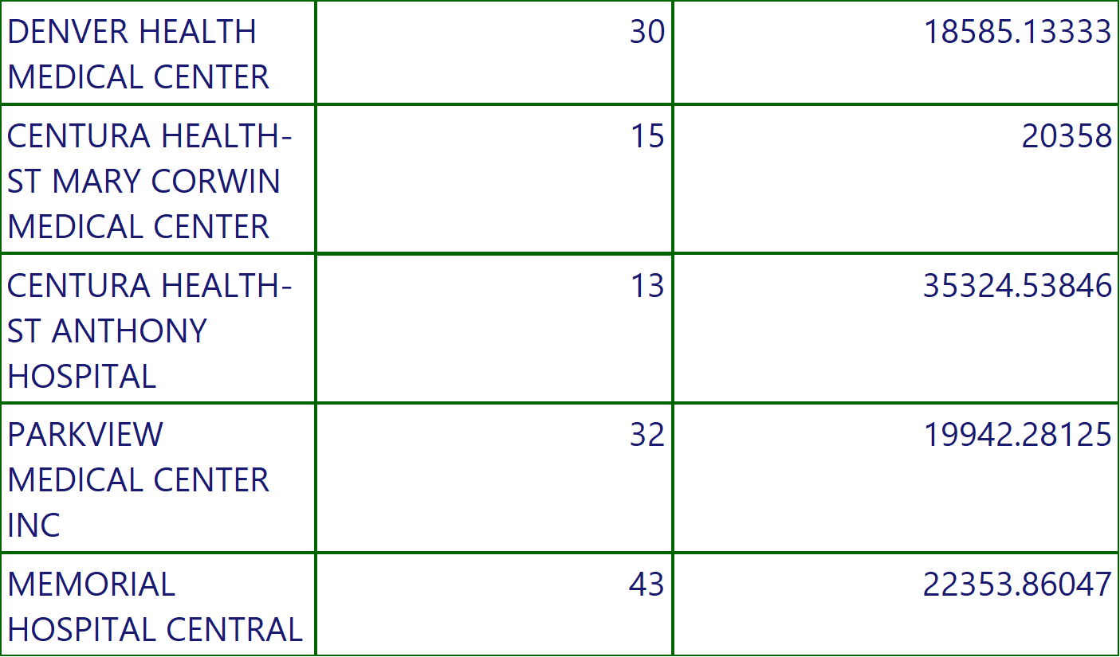
COVID STATE REPORT
Execution Time-10/13/2022 10:31:32 AM
50 of 174

Slide 51

COVID STATE REPORT
Execution Time-10/13/2022 10:31:32 AM
51 of 174

Slide 52

COVID STATE REPORT
Execution Time-10/13/2022 10:31:32 AM
52 of 174

Slide 53

COVID STATE REPORT
Execution Time-10/13/2022 10:31:32 AM
53 of 174

Slide 54

COVID STATE REPORT
Execution Time-10/13/2022 10:31:32 AM
54 of 174

Slide 55

COVID STATE REPORT
Execution Time-10/13/2022 10:31:32 AM
55 of 174

Slide 56

COVID STATE REPORT
Execution Time-10/13/2022 10:31:32 AM
56 of 174

Slide 57

COVID STATE REPORT
Execution Time-10/13/2022 10:31:32 AM
57 of 174

Slide 58

COVID STATE REPORT
Execution Time-10/13/2022 10:31:32 AM
58 of 174

Slide 59

COVID STATE REPORT
Execution Time-10/13/2022 10:31:32 AM
59 of 174

Slide 60

COVID STATE REPORT
Execution Time-10/13/2022 10:31:32 AM
60 of 174

Slide 61

COVID STATE REPORT
Execution Time-10/13/2022 10:31:32 AM
61 of 174

Slide 62

COVID STATE REPORT
Execution Time-10/13/2022 10:31:32 AM
62 of 174

Slide 63

COVID STATE REPORT
Execution Time-10/13/2022 10:31:32 AM
63 of 174

Slide 64

COVID STATE REPORT
Execution Time-10/13/2022 10:31:32 AM
64 of 174

Slide 65

COVID STATE REPORT
Execution Time-10/13/2022 10:31:32 AM
65 of 174

Slide 66

COVID STATE REPORT
Execution Time-10/13/2022 10:31:32 AM
66 of 174

Slide 67

COVID STATE REPORT
Execution Time-10/13/2022 10:31:32 AM
67 of 174

Slide 68

COVID STATE REPORT
Execution Time-10/13/2022 10:31:32 AM
68 of 174

Slide 69

COVID STATE REPORT
Execution Time-10/13/2022 10:31:32 AM
69 of 174

Slide 70

COVID STATE REPORT
Execution Time-10/13/2022 10:31:32 AM
70 of 174

Slide 71

COVID STATE REPORT
Execution Time-10/13/2022 10:31:32 AM
71 of 174

Slide 72

COVID STATE REPORT
Execution Time-10/13/2022 10:31:32 AM
72 of 174

Slide 73

COVID STATE REPORT
Execution Time-10/13/2022 10:31:32 AM
73 of 174

Slide 74

COVID STATE REPORT
Execution Time-10/13/2022 10:31:32 AM
74 of 174

Slide 75

COVID STATE REPORT
Execution Time-10/13/2022 10:31:32 AM
75 of 174

Slide 76

COVID STATE REPORT
Execution Time-10/13/2022 10:31:32 AM
76 of 174

Slide 77

COVID STATE REPORT
Execution Time-10/13/2022 10:31:32 AM
77 of 174

Slide 78

COVID STATE REPORT
Execution Time-10/13/2022 10:31:32 AM
78 of 174

Slide 79

COVID STATE REPORT
Execution Time-10/13/2022 10:31:32 AM
79 of 174

Slide 80

COVID STATE REPORT
Execution Time-10/13/2022 10:31:32 AM
80 of 174

Slide 81

COVID STATE REPORT
Execution Time-10/13/2022 10:31:32 AM
81 of 174

Slide 82

COVID STATE REPORT
Execution Time-10/13/2022 10:31:32 AM
82 of 174

Slide 83

COVID STATE REPORT
Execution Time-10/13/2022 10:31:32 AM
83 of 174

Slide 84

COVID STATE REPORT
Execution Time-10/13/2022 10:31:32 AM
84 of 174

Slide 85

COVID STATE REPORT
Execution Time-10/13/2022 10:31:32 AM
85 of 174

Slide 86

COVID STATE REPORT
Execution Time-10/13/2022 10:31:32 AM
86 of 174

Slide 87

COVID STATE REPORT
Execution Time-10/13/2022 10:31:32 AM
87 of 174

Slide 88

COVID STATE REPORT
Execution Time-10/13/2022 10:31:32 AM
88 of 174

Slide 89

COVID STATE REPORT
Execution Time-10/13/2022 10:31:32 AM
89 of 174

Slide 90

COVID STATE REPORT
Execution Time-10/13/2022 10:31:32 AM
90 of 174

Slide 91

COVID STATE REPORT
Execution Time-10/13/2022 10:31:32 AM
91 of 174

Slide 92

COVID STATE REPORT
Execution Time-10/13/2022 10:31:32 AM
92 of 174

Slide 93

COVID STATE REPORT
Execution Time-10/13/2022 10:31:32 AM
93 of 174

Slide 94

COVID STATE REPORT
Execution Time-10/13/2022 10:31:32 AM
94 of 174

Slide 95

COVID STATE REPORT
Execution Time-10/13/2022 10:31:32 AM
95 of 174

Slide 96

COVID STATE REPORT
Execution Time-10/13/2022 10:31:32 AM
96 of 174

Slide 97

COVID STATE REPORT
Execution Time-10/13/2022 10:31:32 AM
97 of 174

Slide 98

COVID STATE REPORT
Execution Time-10/13/2022 10:31:32 AM
98 of 174

Slide 99

COVID STATE REPORT
Execution Time-10/13/2022 10:31:32 AM
99 of 174

Slide 100

COVID STATE REPORT
Execution Time-10/13/2022 10:31:32 AM
100 of 174

Slide 101

COVID STATE REPORT
Execution Time-10/13/2022 10:31:32 AM
101 of 174

Slide 102

COVID STATE REPORT
Execution Time-10/13/2022 10:31:32 AM
102 of 174

Slide 103

COVID STATE REPORT
Execution Time-10/13/2022 10:31:32 AM
103 of 174

Slide 104

COVID STATE REPORT
Execution Time-10/13/2022 10:31:32 AM
104 of 174

Slide 105

COVID STATE REPORT
Execution Time-10/13/2022 10:31:32 AM
105 of 174

Slide 106

COVID STATE REPORT
Execution Time-10/13/2022 10:31:32 AM
106 of 174

Slide 107

COVID STATE REPORT
Execution Time-10/13/2022 10:31:32 AM
107 of 174

Slide 108

COVID STATE REPORT
Execution Time-10/13/2022 10:31:32 AM
108 of 174

Slide 109

COVID STATE REPORT
Execution Time-10/13/2022 10:31:32 AM
109 of 174

Slide 110

COVID STATE REPORT
Execution Time-10/13/2022 10:31:32 AM
110 of 174

Slide 111

COVID STATE REPORT
Execution Time-10/13/2022 10:31:32 AM
111 of 174

Slide 112

COVID STATE REPORT
Execution Time-10/13/2022 10:31:32 AM
112 of 174

Slide 113

COVID STATE REPORT
Execution Time-10/13/2022 10:31:32 AM
113 of 174

Slide 114

COVID STATE REPORT
Execution Time-10/13/2022 10:31:32 AM
114 of 174

Slide 115

COVID STATE REPORT
Execution Time-10/13/2022 10:31:32 AM
115 of 174

Slide 116

COVID STATE REPORT
Execution Time-10/13/2022 10:31:32 AM
116 of 174

Slide 117

COVID STATE REPORT
Execution Time-10/13/2022 10:31:32 AM
117 of 174

Slide 118

COVID STATE REPORT
Execution Time-10/13/2022 10:31:32 AM
118 of 174

Slide 119

COVID STATE REPORT
Execution Time-10/13/2022 10:31:32 AM
119 of 174

Slide 120

COVID STATE REPORT
Execution Time-10/13/2022 10:31:32 AM
120 of 174

Slide 121

COVID STATE REPORT
Execution Time-10/13/2022 10:31:32 AM
121 of 174

Slide 122

COVID STATE REPORT
Execution Time-10/13/2022 10:31:32 AM
122 of 174

Slide 123

COVID STATE REPORT
Execution Time-10/13/2022 10:31:32 AM
123 of 174

Slide 124

COVID STATE REPORT
Execution Time-10/13/2022 10:31:32 AM
124 of 174

Slide 125

COVID STATE REPORT
Execution Time-10/13/2022 10:31:32 AM
125 of 174

Slide 126

COVID STATE REPORT
Execution Time-10/13/2022 10:31:32 AM
126 of 174

Slide 127

COVID STATE REPORT
Execution Time-10/13/2022 10:31:32 AM
127 of 174

Slide 128

COVID STATE REPORT
Execution Time-10/13/2022 10:31:32 AM
128 of 174

Slide 129

COVID STATE REPORT
Execution Time-10/13/2022 10:31:32 AM
129 of 174

Slide 130

COVID STATE REPORT
Execution Time-10/13/2022 10:31:32 AM
130 of 174

Slide 131

COVID STATE REPORT
Execution Time-10/13/2022 10:31:32 AM
131 of 174

Slide 132

COVID STATE REPORT
Execution Time-10/13/2022 10:31:32 AM
132 of 174

Slide 133

COVID STATE REPORT
Execution Time-10/13/2022 10:31:32 AM
133 of 174

Slide 134

COVID STATE REPORT
Execution Time-10/13/2022 10:31:32 AM
134 of 174

Slide 135

COVID STATE REPORT
Execution Time-10/13/2022 10:31:32 AM
135 of 174

Slide 136

COVID STATE REPORT
Execution Time-10/13/2022 10:31:32 AM
136 of 174

Slide 137

COVID STATE REPORT
Execution Time-10/13/2022 10:31:32 AM
137 of 174

Slide 138

COVID STATE REPORT
Execution Time-10/13/2022 10:31:32 AM
138 of 174

Slide 139

COVID STATE REPORT
Execution Time-10/13/2022 10:31:32 AM
139 of 174

Slide 140

COVID STATE REPORT
Execution Time-10/13/2022 10:31:32 AM
140 of 174

Slide 141

COVID STATE REPORT
Execution Time-10/13/2022 10:31:32 AM
141 of 174

Slide 142

COVID STATE REPORT
Execution Time-10/13/2022 10:31:32 AM
142 of 174

Slide 143

COVID STATE REPORT
Execution Time-10/13/2022 10:31:32 AM
143 of 174

Slide 144

COVID STATE REPORT
Execution Time-10/13/2022 10:31:32 AM
144 of 174

Slide 145

COVID STATE REPORT
Execution Time-10/13/2022 10:31:32 AM
145 of 174

Slide 146

COVID STATE REPORT
Execution Time-10/13/2022 10:31:32 AM
146 of 174

Slide 147

COVID STATE REPORT
Execution Time-10/13/2022 10:31:32 AM
147 of 174

Slide 148

COVID STATE REPORT
Execution Time-10/13/2022 10:31:32 AM
148 of 174

Slide 149

COVID STATE REPORT
Execution Time-10/13/2022 10:31:32 AM
149 of 174

Slide 150

COVID STATE REPORT
Execution Time-10/13/2022 10:31:32 AM
150 of 174

Slide 151

COVID STATE REPORT
Execution Time-10/13/2022 10:31:32 AM
151 of 174

Slide 152

COVID STATE REPORT
Execution Time-10/13/2022 10:31:32 AM
152 of 174

Slide 153

COVID STATE REPORT
Execution Time-10/13/2022 10:31:32 AM
153 of 174

Slide 154

COVID STATE REPORT
Execution Time-10/13/2022 10:31:32 AM
154 of 174

Slide 155

COVID STATE REPORT
Execution Time-10/13/2022 10:31:32 AM
155 of 174

Slide 156

COVID STATE REPORT
Execution Time-10/13/2022 10:31:32 AM
156 of 174

Slide 157

COVID STATE REPORT
Execution Time-10/13/2022 10:31:32 AM
157 of 174

Slide 158

COVID STATE REPORT
Execution Time-10/13/2022 10:31:32 AM
158 of 174

Slide 159

COVID STATE REPORT
Execution Time-10/13/2022 10:31:32 AM
159 of 174

Slide 160

COVID STATE REPORT
Execution Time-10/13/2022 10:31:32 AM
160 of 174

Slide 161

COVID STATE REPORT
Execution Time-10/13/2022 10:31:32 AM
161 of 174

Slide 162

COVID STATE REPORT
Execution Time-10/13/2022 10:31:32 AM
162 of 174

Slide 163

COVID STATE REPORT
Execution Time-10/13/2022 10:31:32 AM
163 of 174

Slide 164

COVID STATE REPORT
Execution Time-10/13/2022 10:31:32 AM
164 of 174

Slide 165

COVID STATE REPORT
Execution Time-10/13/2022 10:31:32 AM
165 of 174

Slide 166

COVID STATE REPORT
Execution Time-10/13/2022 10:31:32 AM
166 of 174

Slide 167

COVID STATE REPORT
Execution Time-10/13/2022 10:31:32 AM
167 of 174

Slide 168

COVID STATE REPORT
Execution Time-10/13/2022 10:31:32 AM
168 of 174

Slide 169

COVID STATE REPORT
Execution Time-10/13/2022 10:31:32 AM
169 of 174

Slide 170

COVID STATE REPORT
Execution Time-10/13/2022 10:31:32 AM
170 of 174

Slide 171

COVID STATE REPORT
Execution Time-10/13/2022 10:31:32 AM
171 of 174

Slide 172

COVID STATE REPORT
Execution Time-10/13/2022 10:31:32 AM
172 of 174

Slide 173

COVID STATE REPORT
Execution Time-10/13/2022 10:31:32 AM
173 of 174

Slide 174
COVID STATE REPORT
Execution Time-10/13/2022 10:31:32 AM
174 of 174

